Slide 1
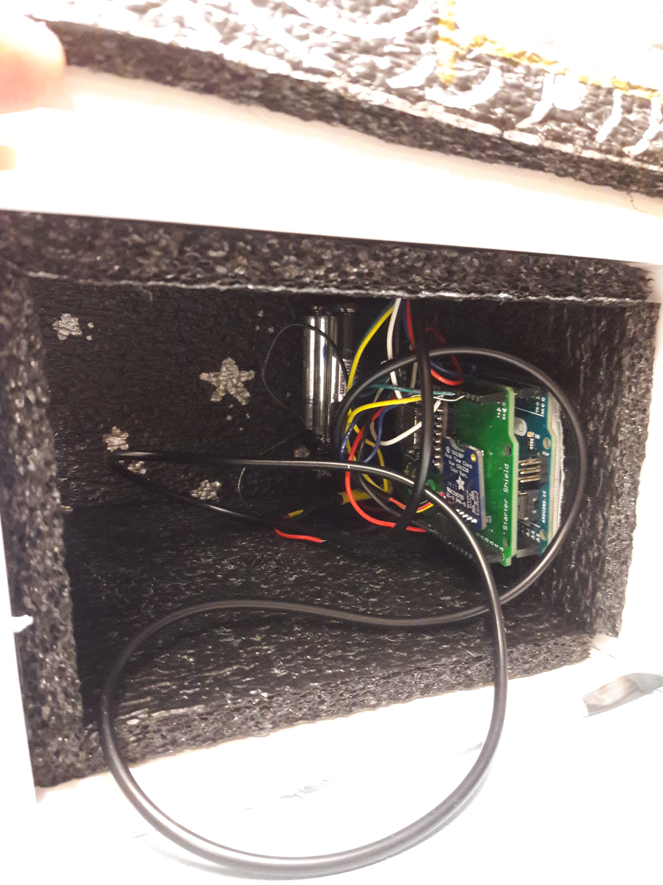
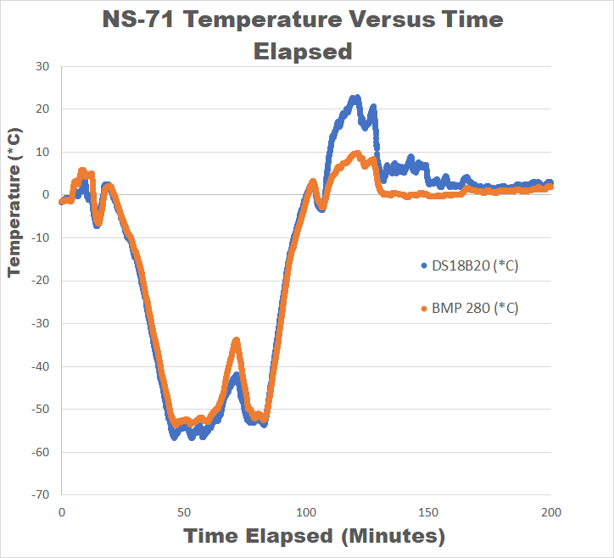
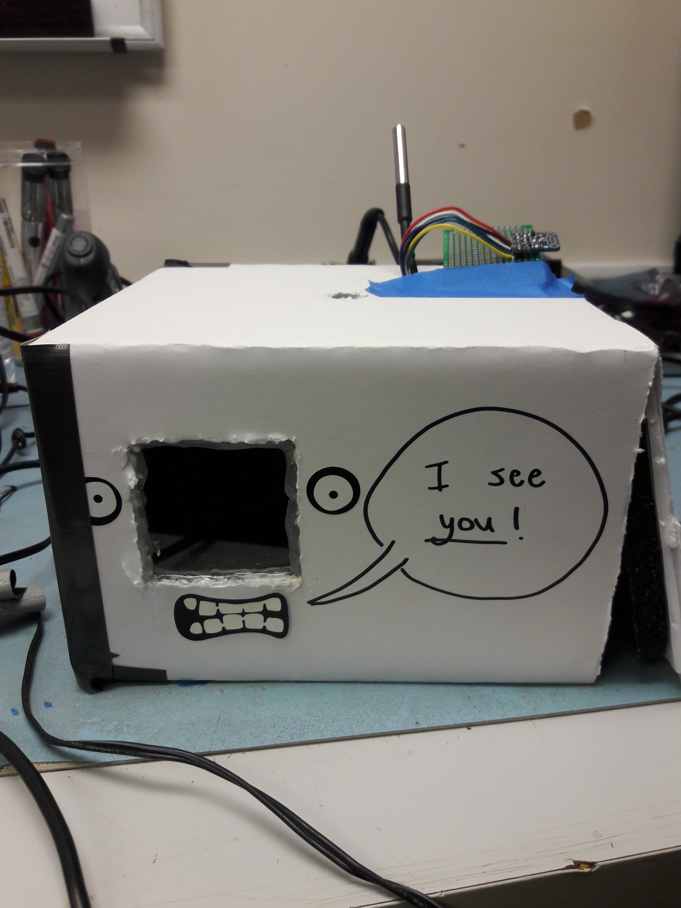
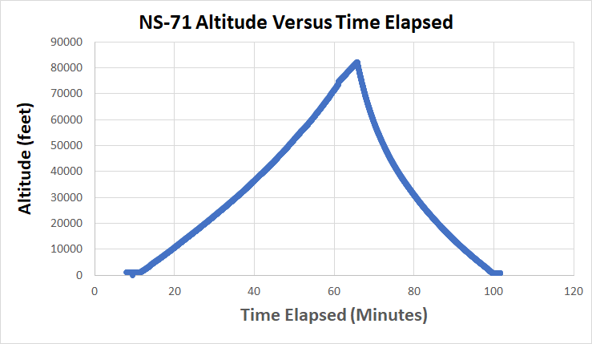
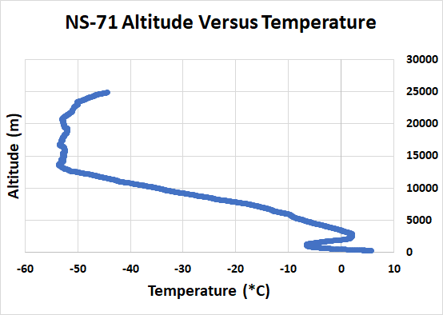
TEMPERATURE VS. ALTITUDE EXPERIMENT
Balloon Payload Program, Sensors Group
Gilad Gensler
Alexandros Tzamaras
David Solonsky
Israel Ayoade
Advisors: Dale Martin
Sky Onimus
Ji Chang
Dr. Mary Bowden
Research Summary:
The main purpose of weather balloons is to send scientific instruments, called “payloads” to near-space environments to collect information and conduct research. Our plan was to compare data from 3 different types of temperature sensors, to see which is the most accurate. The types of sensors chosen were:
Resistance Temperature Detector (RTD)
Micro-electrical Mechanical System (MEMS)
Thermistor temperature sensor (has electrical resistance to respond to temp changes)
Methodology
We initially conducted background research on the 3 types of temp sensors, and selected 2 of each for further study.
We then split into two sub- teams, with one team focused on constructing the payload box, and the other team focused on the wiring and coding of the sensors. There were challenges coding the sensors, resulting in just two of the sensors, the BMP280 MEMS sensor and the DS18B20 Digital Thermometer sensor to be ready for launch.
The sensors were hooked up to an Arduino Uno board and programmed. When this was done, our box was thermal tested, and on Saturday, November 11th, we launched.
Objective
Determine which type of temperature sensor is the most accurate, and compare temperature vs. altitude.
Outcomes
Our payload was a success.
We had initially planned to fly 6 sensors and compare them, but due to time constraints, only flew two. The two we flew were successful in giving us comparable results to fulfill our objective.
The max altitude the payloads reached was about 81,500 feet. According to a table of the standard atmosphere, at around 80000ft, the temperature is -56.5˚C. At burst (81,500ft) each sensor gave a reading in the range of -50 to -60 degrees Celsius. The digital thermometer (DS18B20) was more accurate in reading the temperature, because the BMP sensor is primarily used for barometric pressure, but has the capability to take temp measurements as well.
As expected, the temperature generally seems to go down as the altitude rises.
*Special thanks to the Maryland Space Grant Consortium*
Notes:
1

