Slide 1
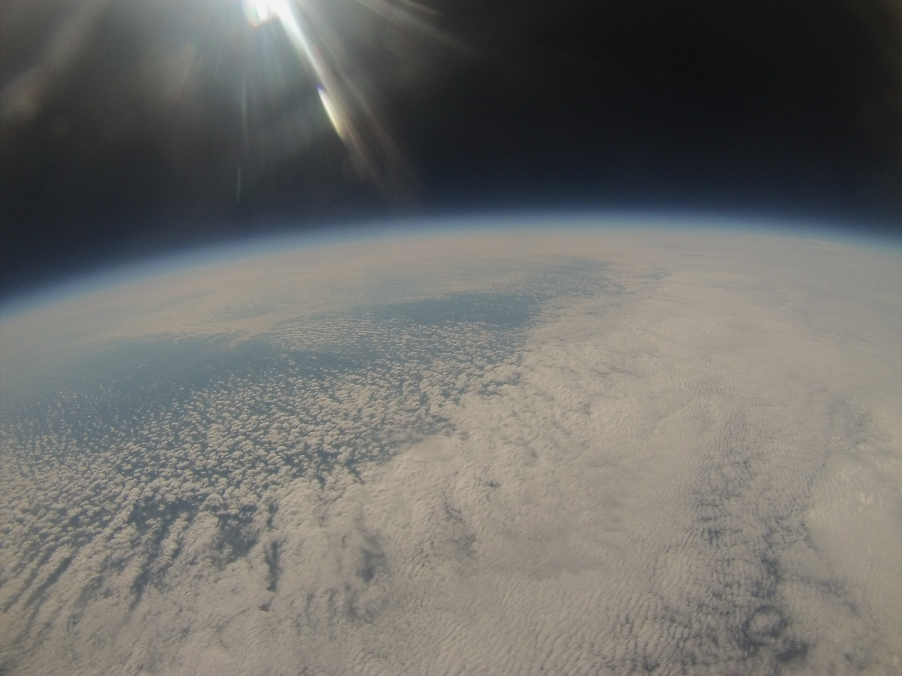
The World from 90,000ft
By: Tyler Boyle, a University of Maryland student

Slide 2
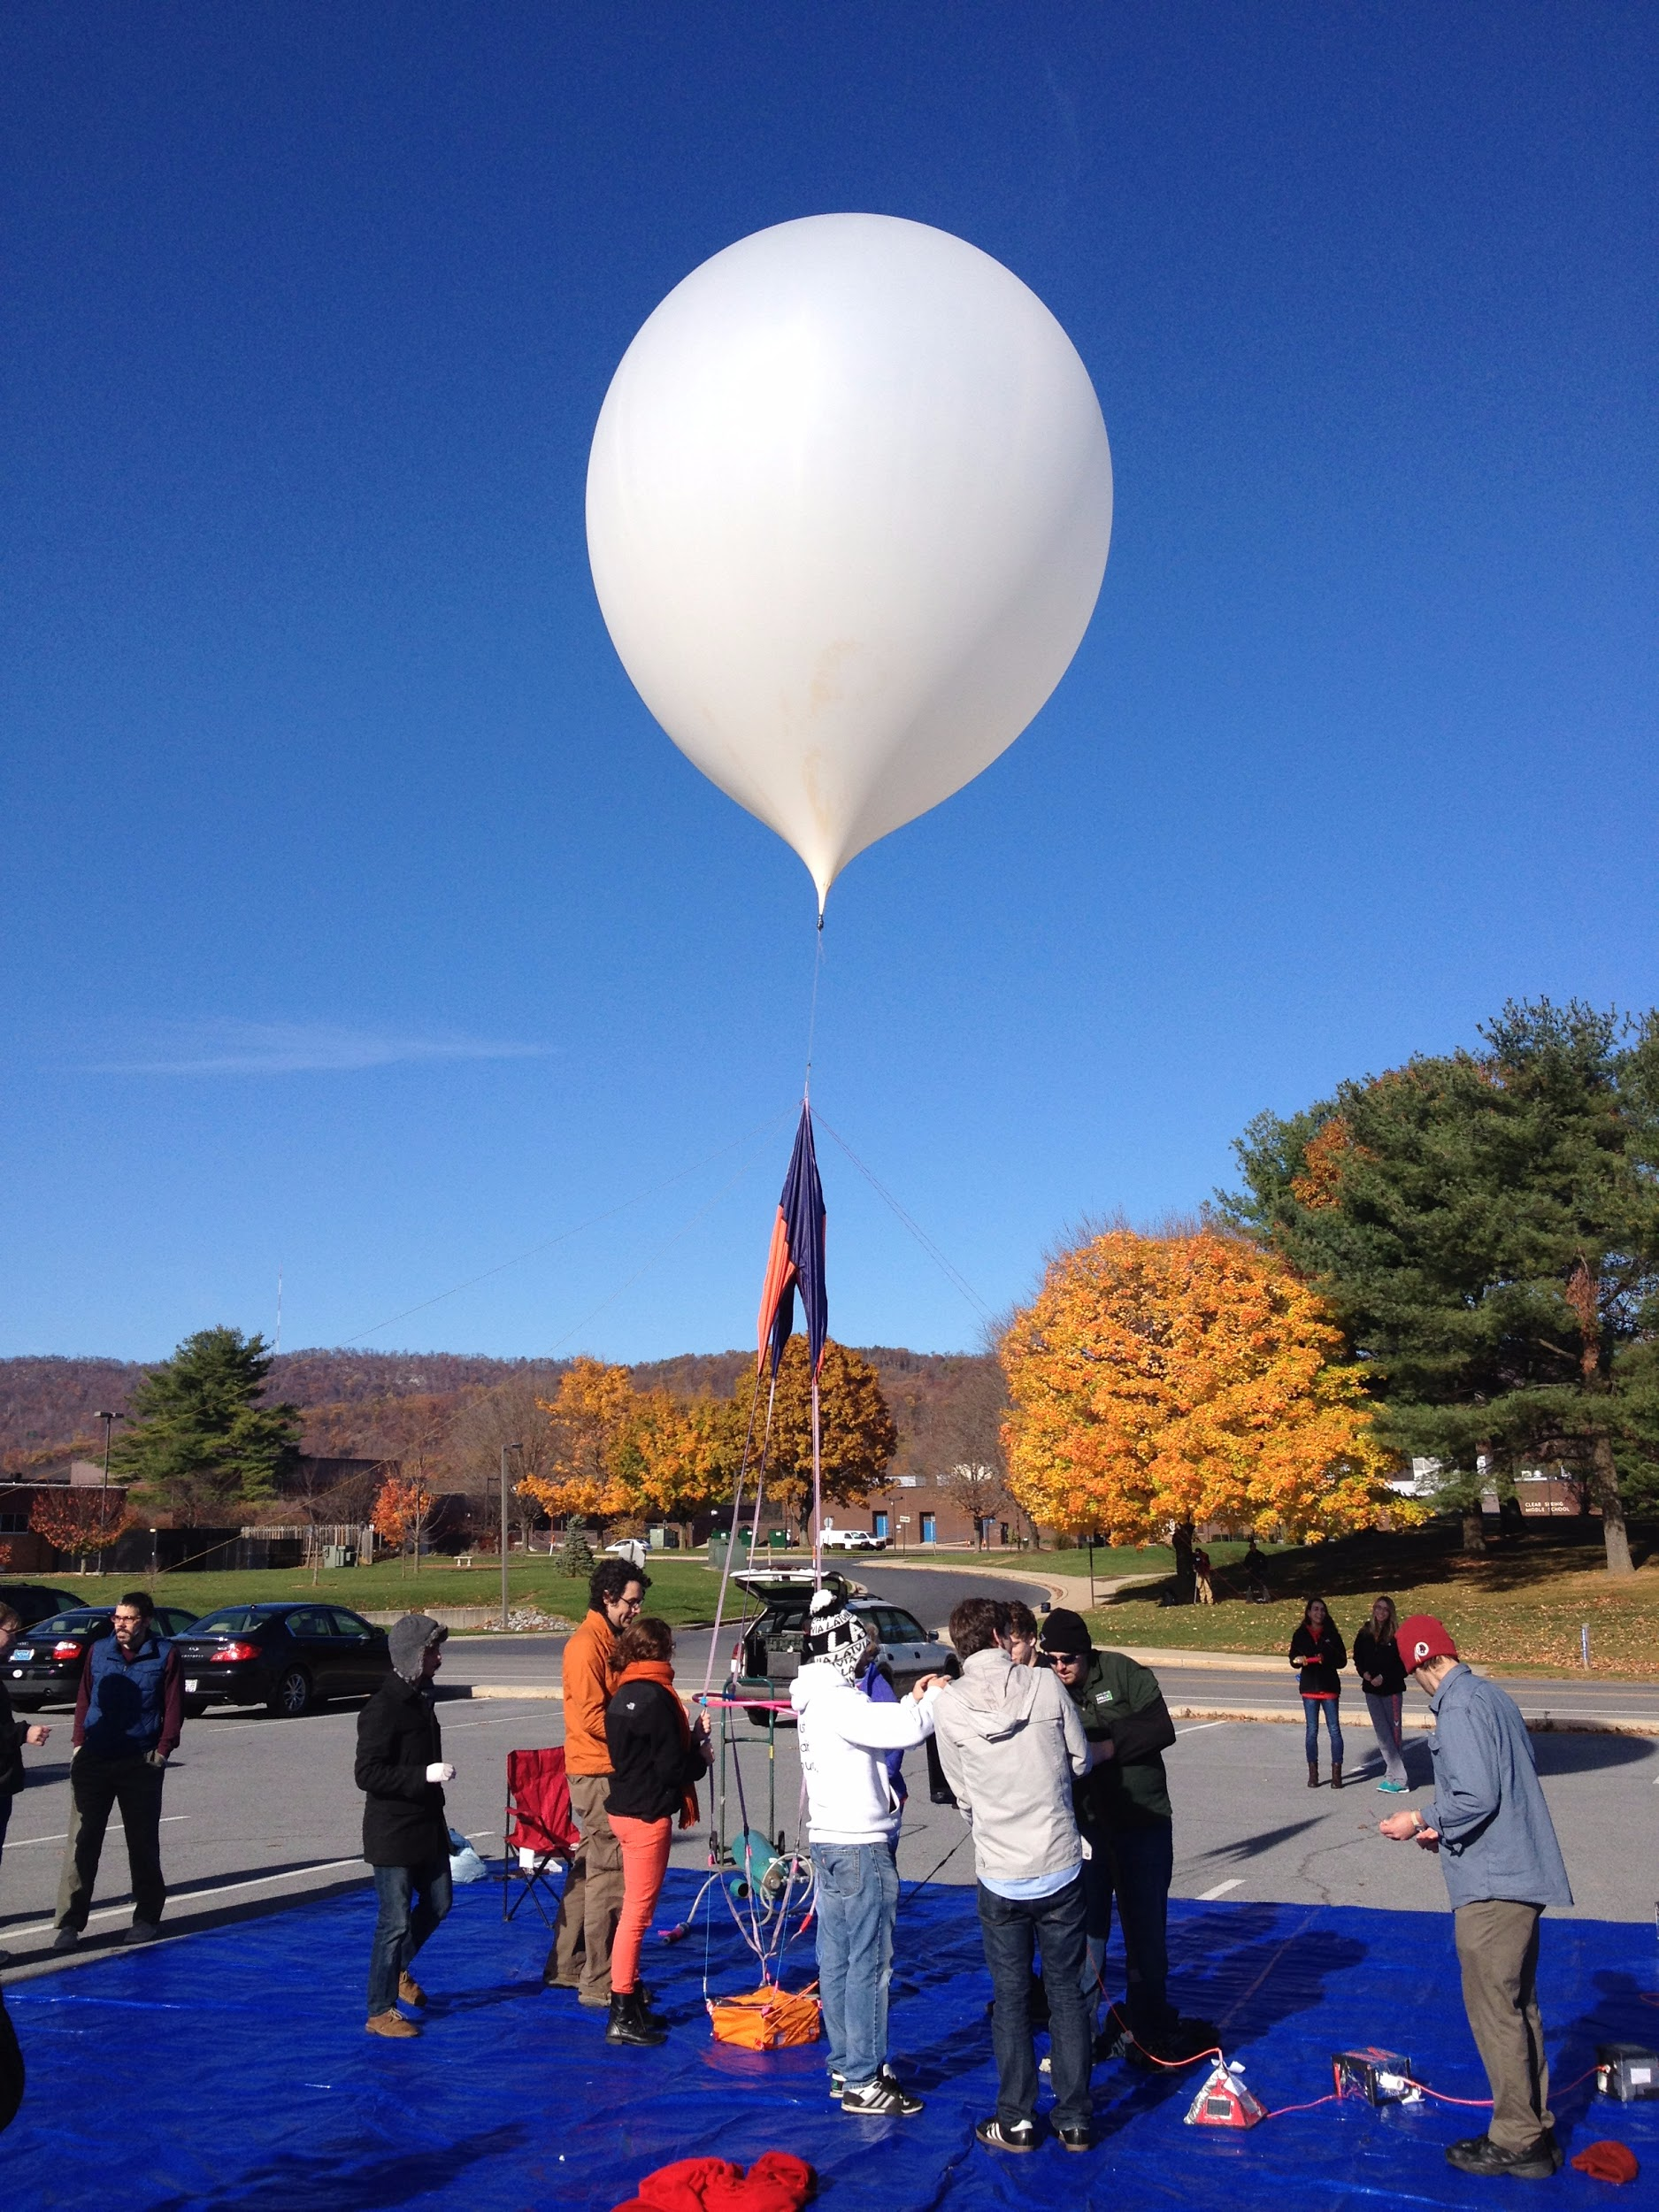
Who are we?
We are aerospace engineers, computer scientists, and atmospheric scientists at the University of Maryland who love to tinker and build things
We design, build, and test our experiments

Slide 3
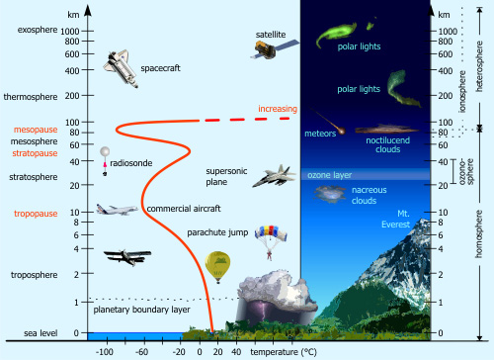
Where does our stuff go?
The payloads we build fly into the stratosphere
(sometimes above 100,000ft!)

Slide 4
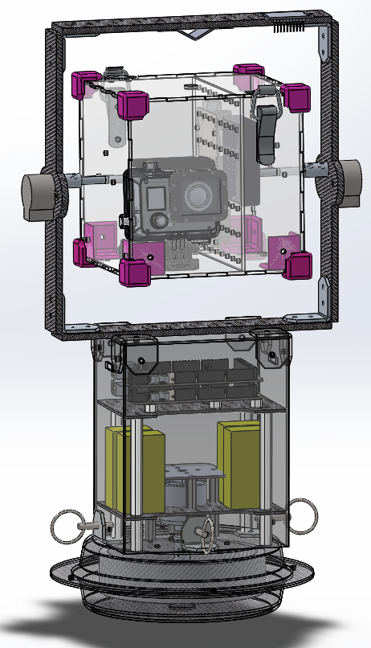
What do we build?
We build payloads that:
Can “talk” to us while in flight (LINK)
Drop other payloads (MARS)
Try to break the sound barrier (Super Sonic)
Stabilize something - so you can point a sensor or a GoPro at something like the sun for the entire flight and take measurements (Bad Attitude)
Try to keep balloon up in the air or just floating for longer (Helios)
Payload stabilizing unit, made with custom designed parts

Slide 5
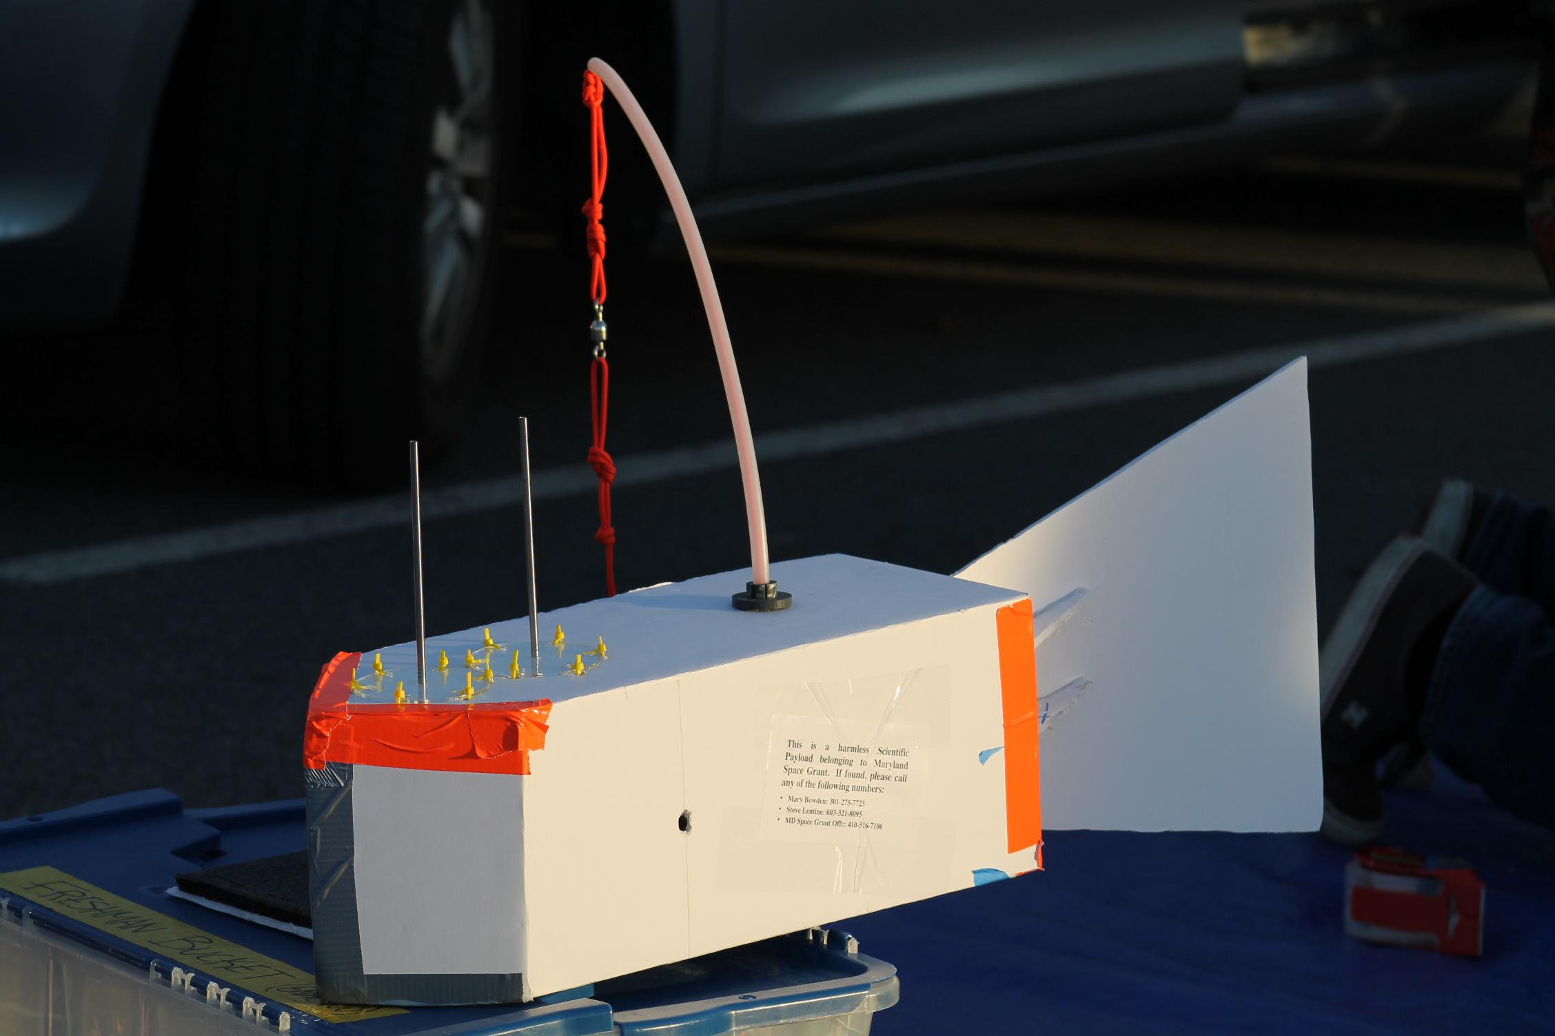
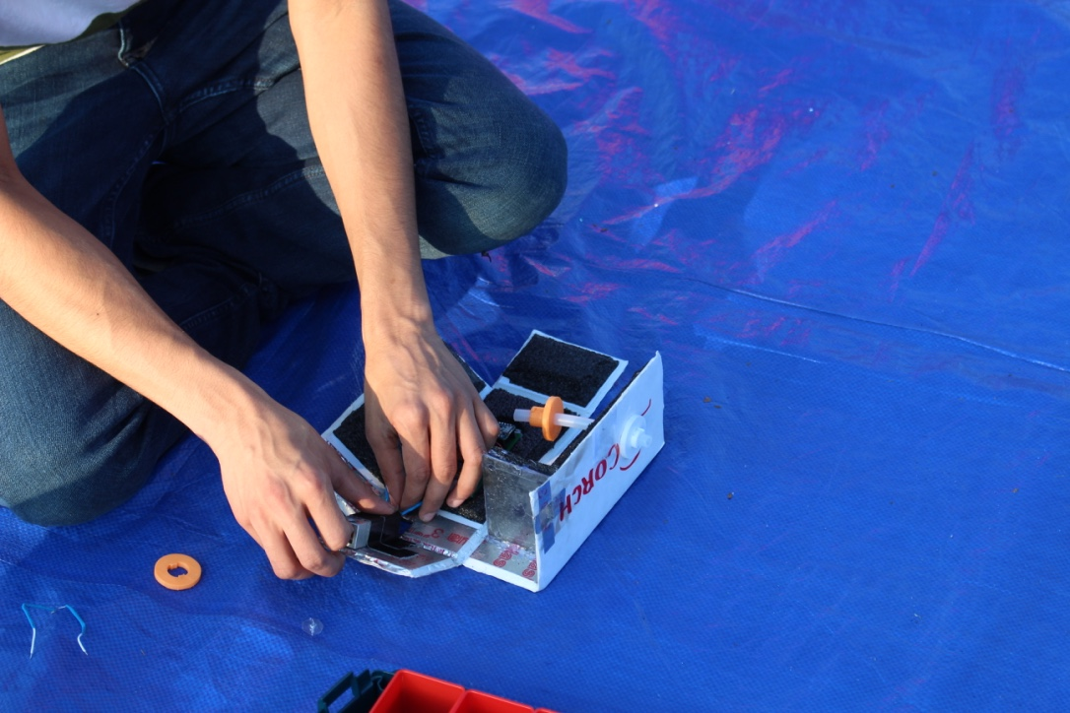
Some payloads
FISH - designed to measure velocity in the air
SCORCH - Uses a model rocket engine to burn a hole in the payload string

Slide 6
Bach’s Box and Tyrion
Payloads my group works on
“Tyrion” and “Bach’s Box” Measure:
Temperature
Pressure
Humidity
Dust
GPS position
Wind speed and Direction

Slide 7
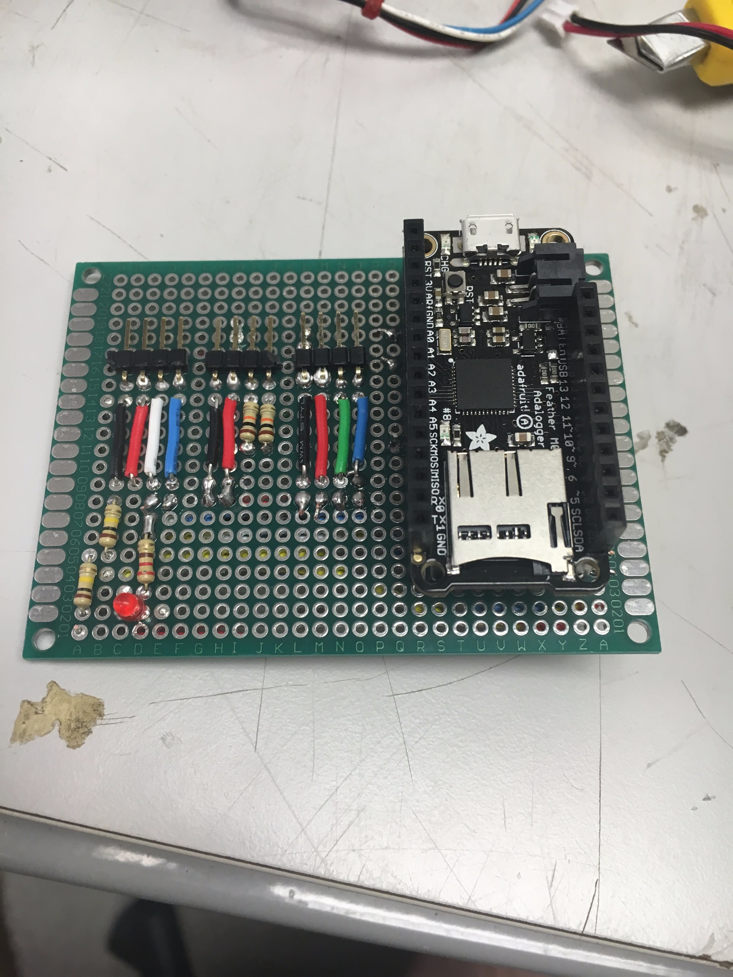
How do we measure that?
By building “circuit boards” with Arduinos
Adafruit Feather
BME 280 temperature, pressure, and humidity sensor
These are all things that are cheap and easy, you can build one if you want!
Tyrion, Version 2

Slide 8
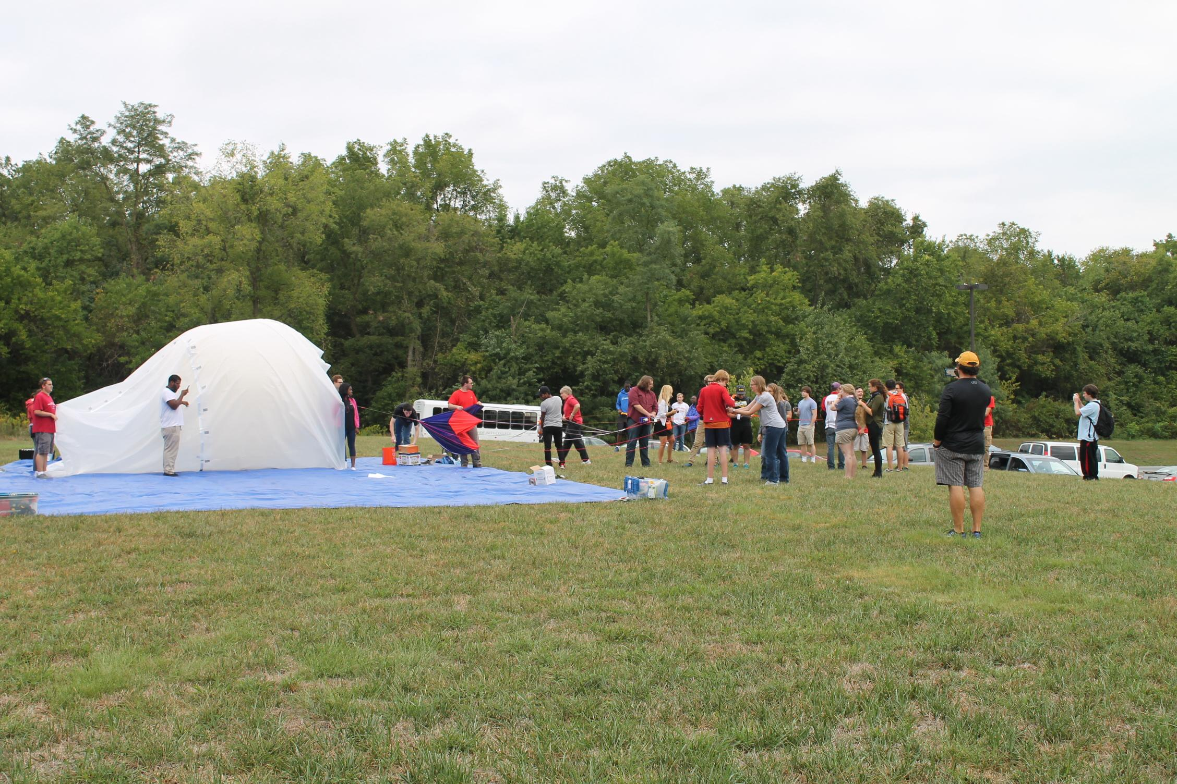
Making this happen

Slide 9
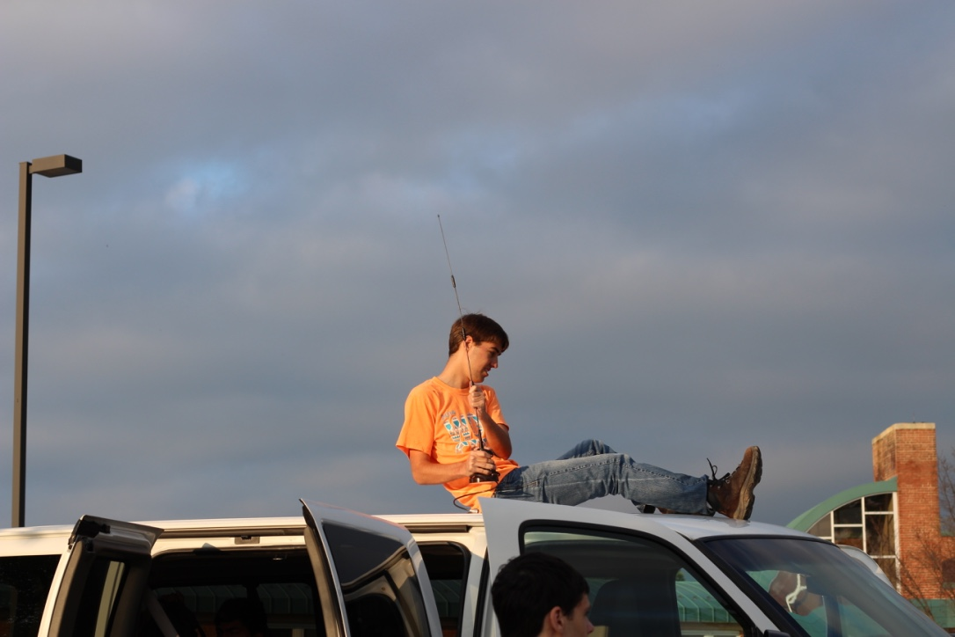
The Night before the Launch
Tying all of the payloads together on the string
Setting up the vans with our radio equipment

Slide 10
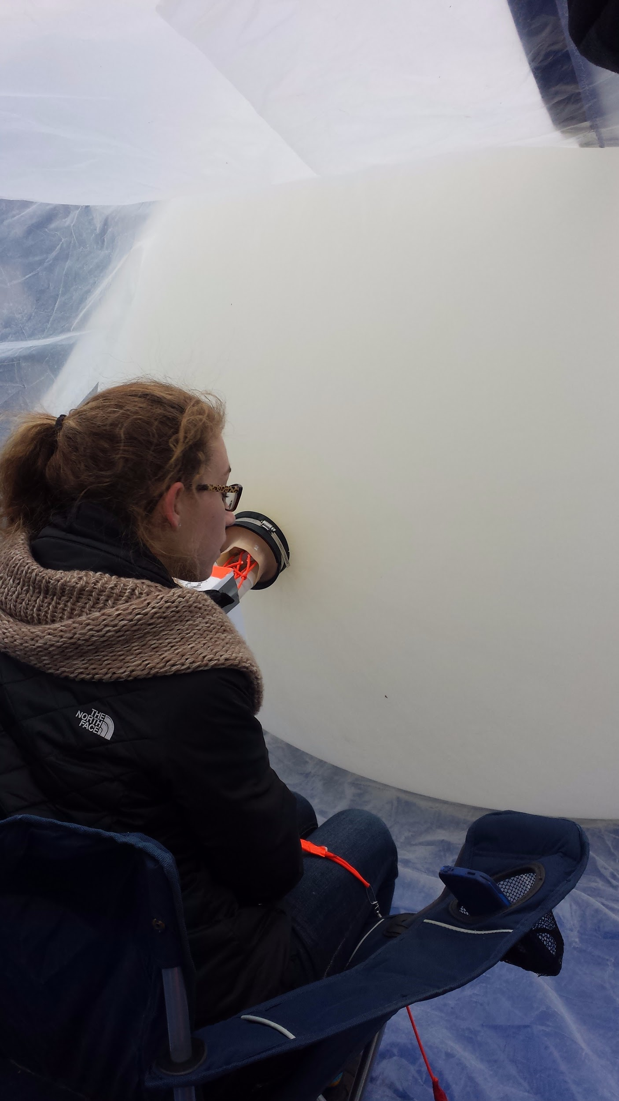
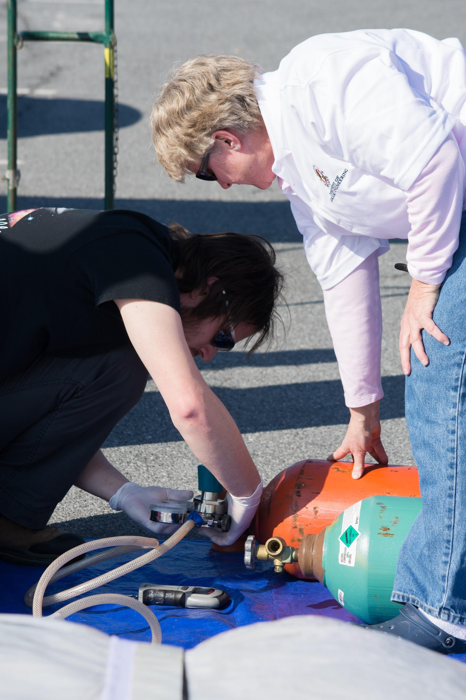
Launch Day
It’s not that easy...
Waking up early
Setting up the “payload string”
Last minute calibrations
Checking all radio communications
Filling up the balloon
Last Minute predictions
Filling up the balloon

Slide 11
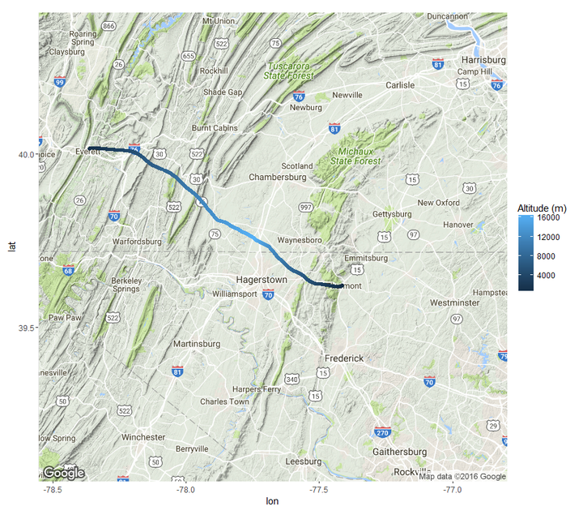
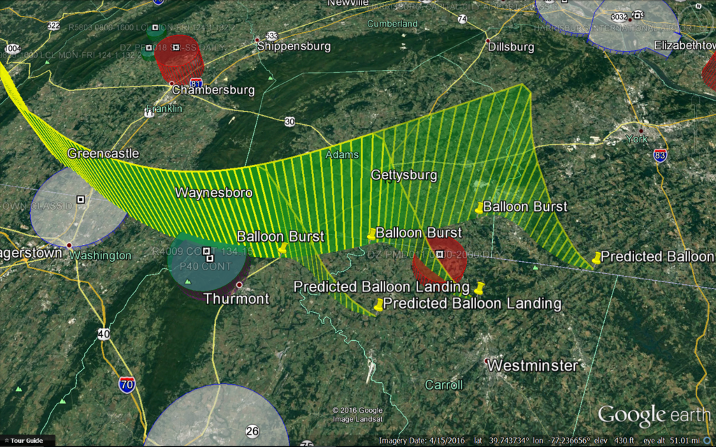
Predictions vs. Reality
Predicted ground track (left) vs. actual flight (right)
Notes:
Things don’t happen the way we always expect

Slide 12
How do we make these predictions?
We look at the jet stream, and the other layers of the lower atmosphere
Think of the atmosphere like a cake (where the icing, or the jet stream, is the most important)
For our October 29th launch, the jet stream was moving everything really fast to the east
https://earth.nullschool.net/#2016/10/29/1200Z/wind/isobaric/250hPa/orthographic=-89.12,40.00,1123

Slide 13
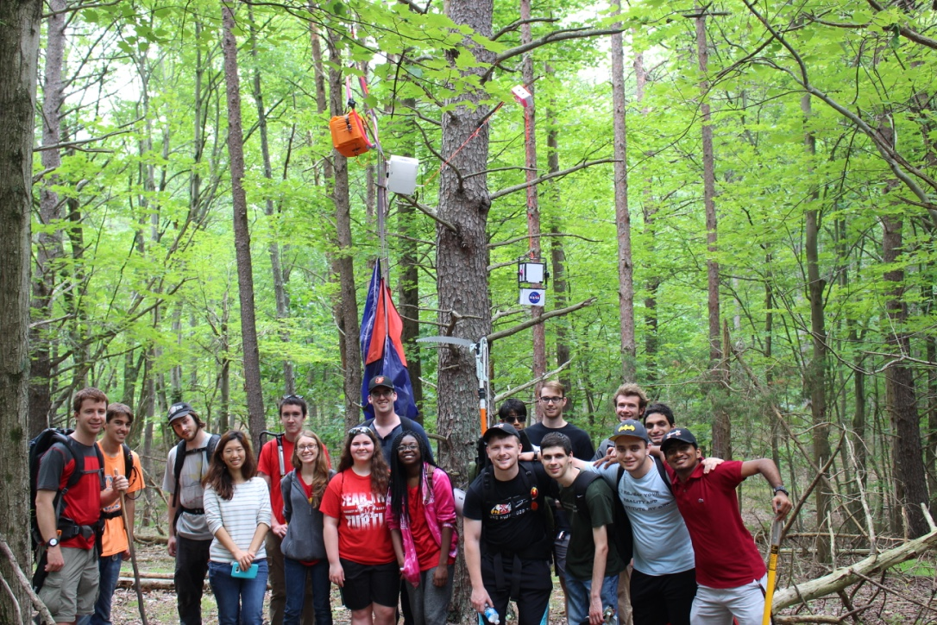
And the inevitable tree landing
The first rule of ballooning - if there’s a tree nearby, your balloon will find it!!
The NS55 landing site

Slide 14
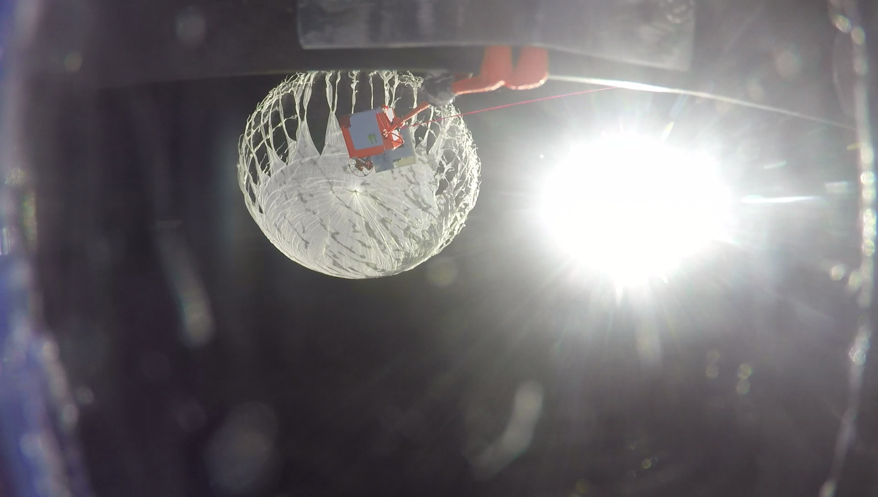
Sometimes, we just have bad luck
At the last launch, the balloon burst at 30,000 ft before we expected
NS53 GoPro footage capturing a balloon bursting

Slide 15
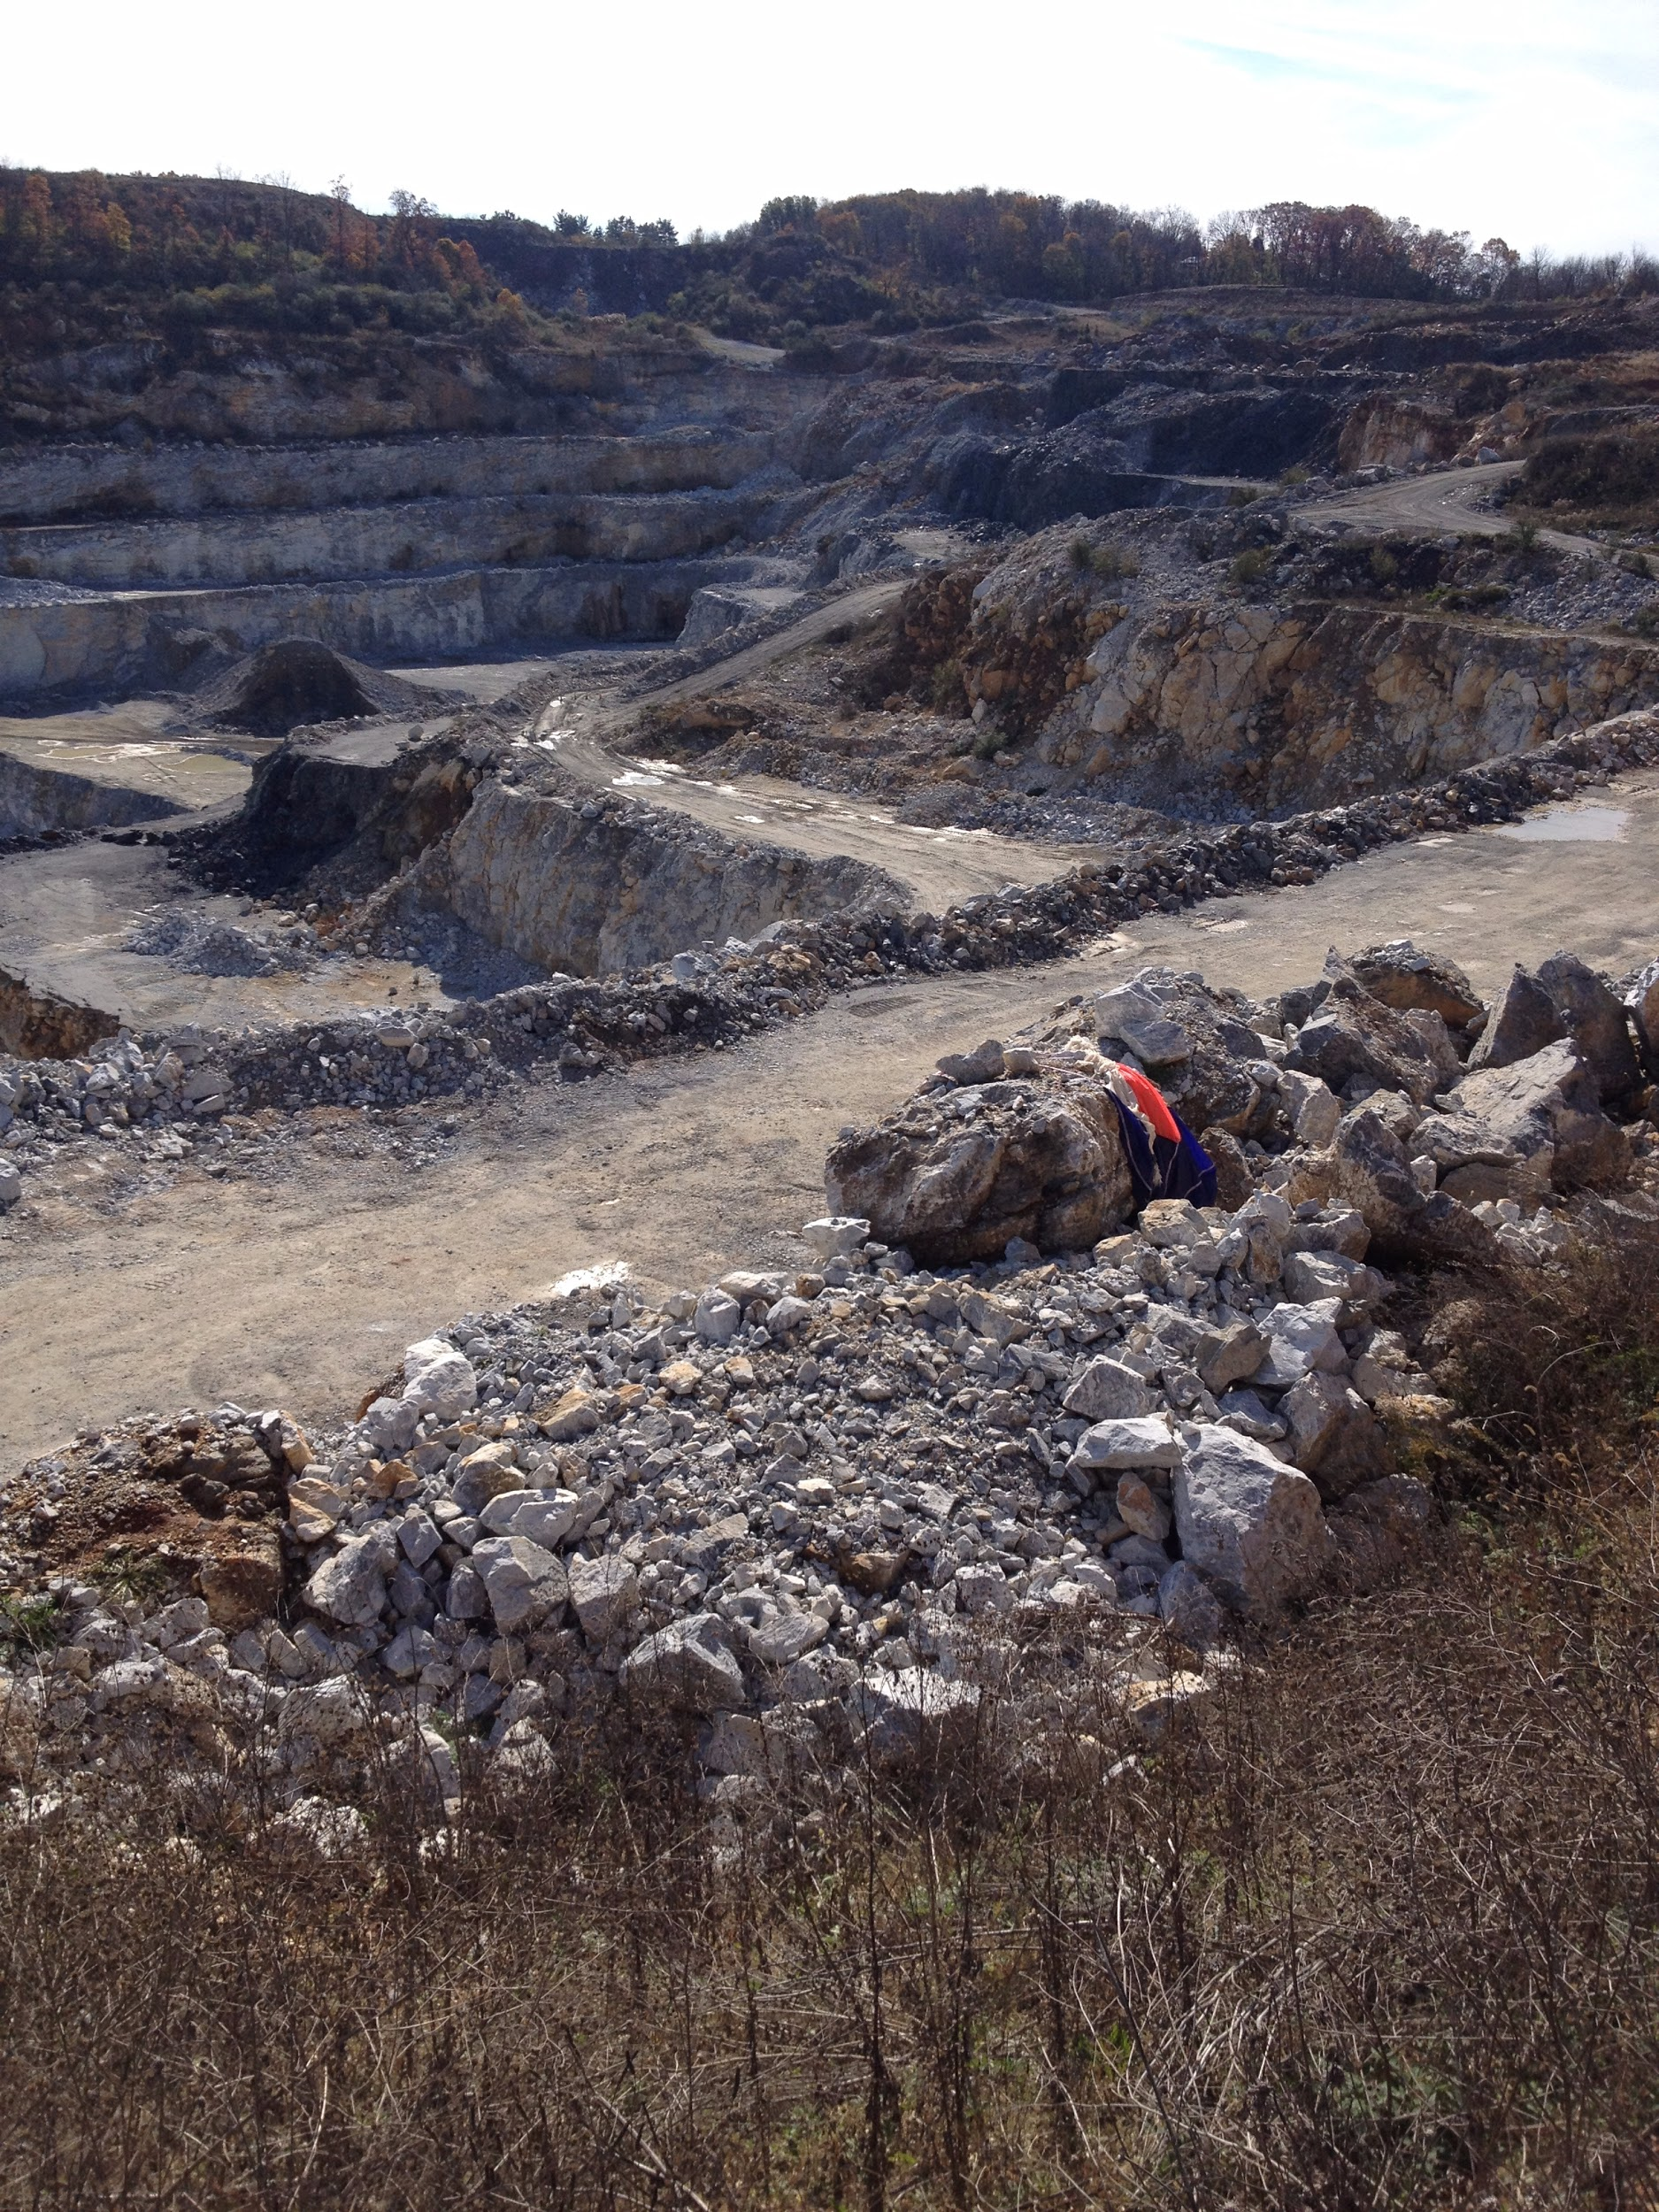
Or someplace inconvenient
Or it will land in a place that’s very hard to get
At NS45 we landed in a quarry

Slide 16
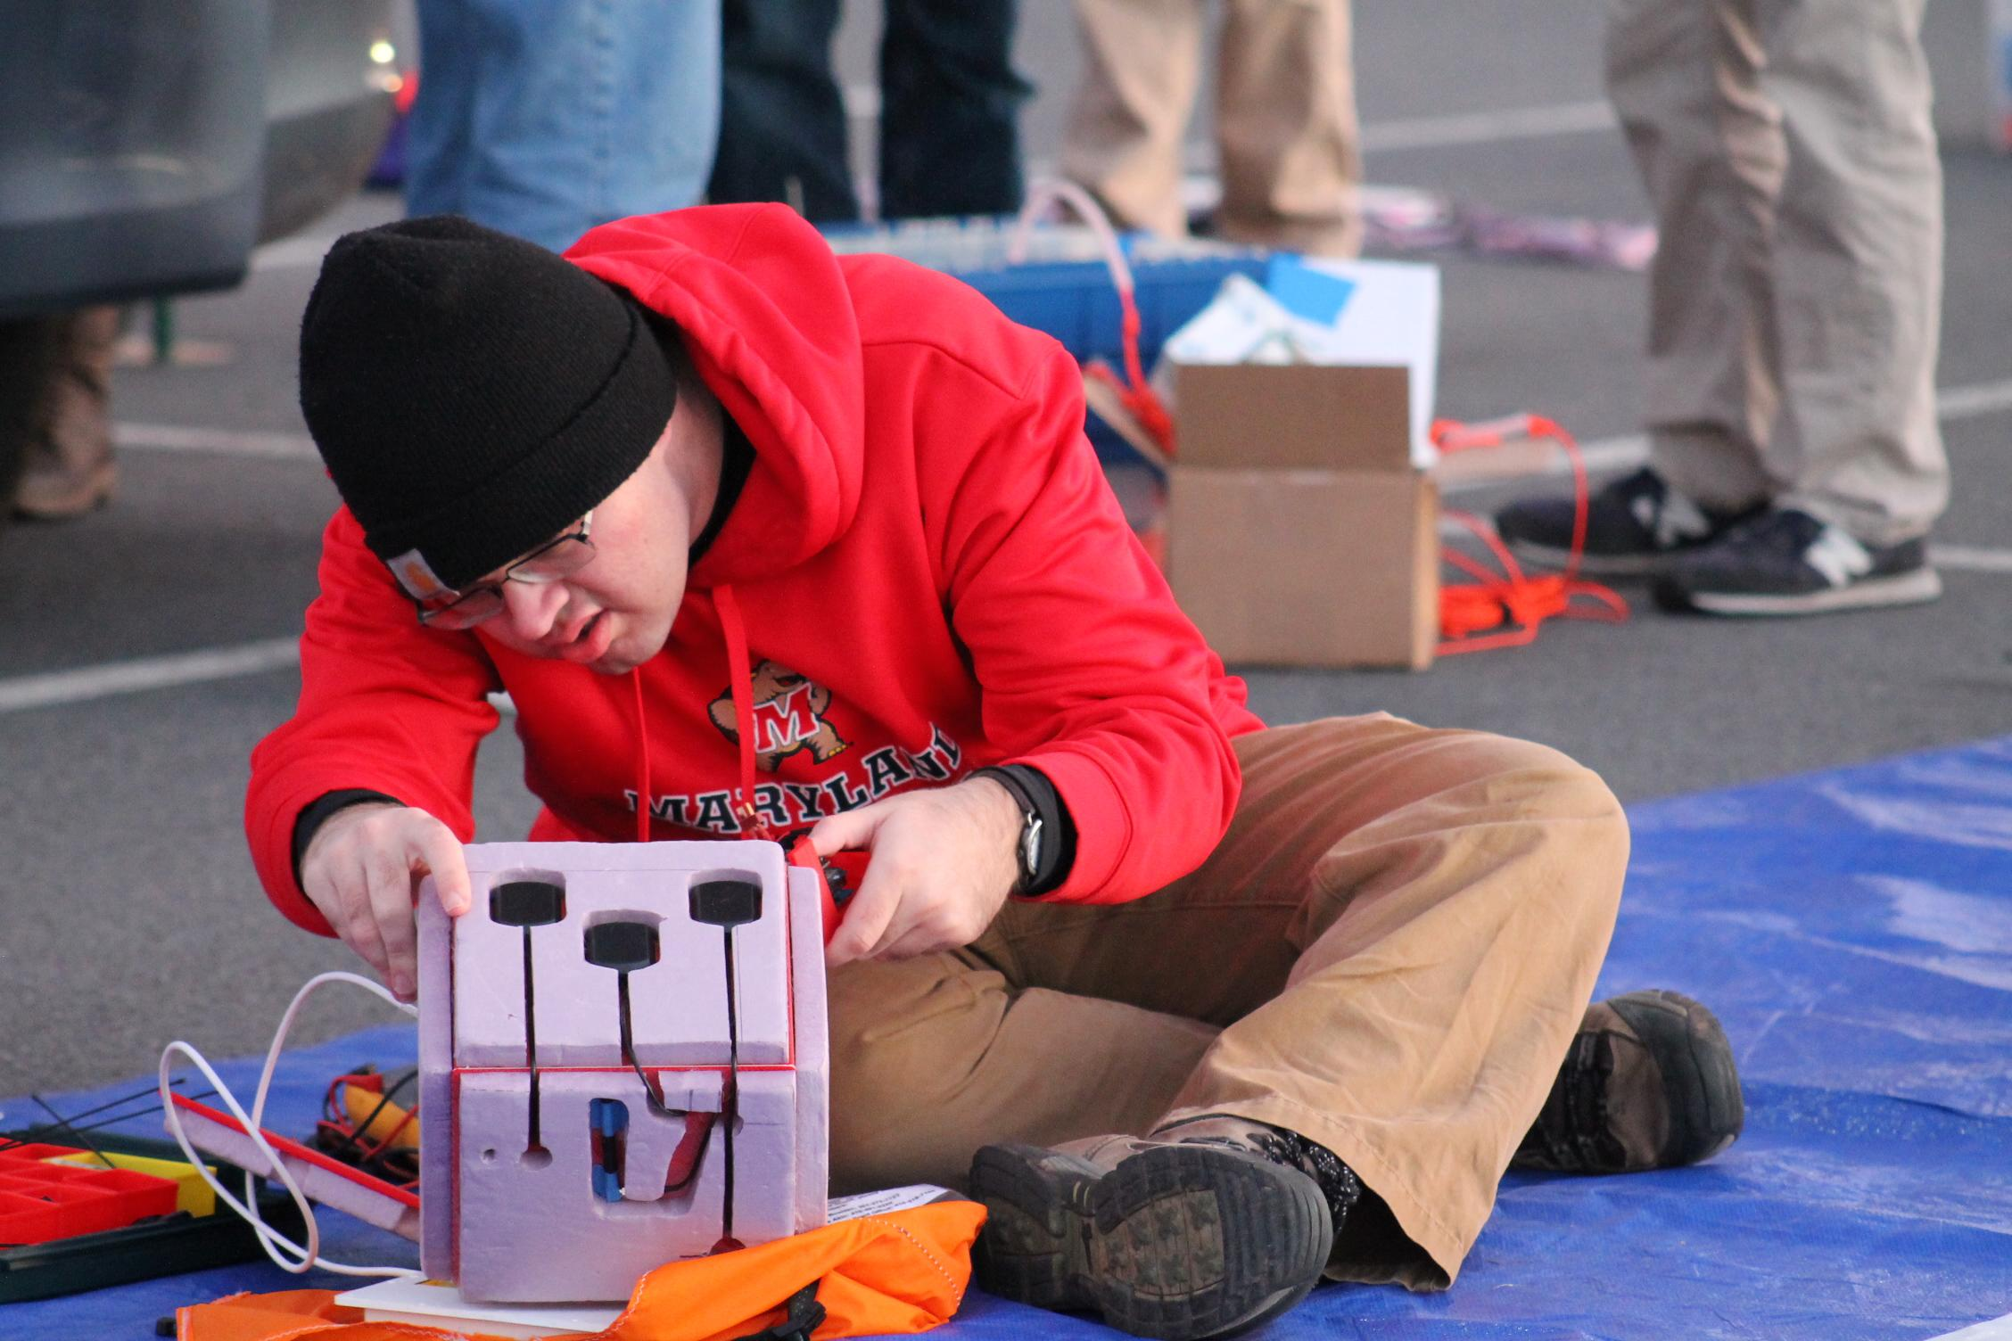
Why go through all this trouble?
Luke getting command module ready for flight

Slide 17
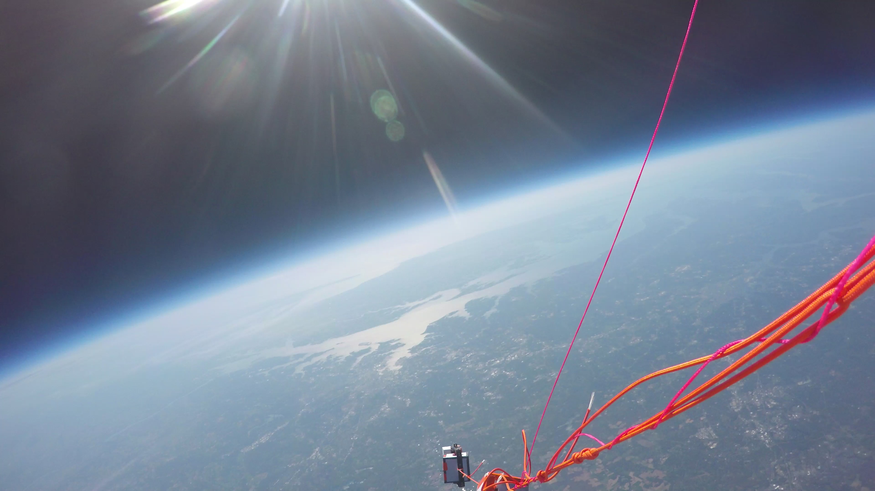
Well, the pictures are always cool!
Photo from NS54, where you can see the Chesapeake Bay and even the Atlantic Ocean

Slide 18
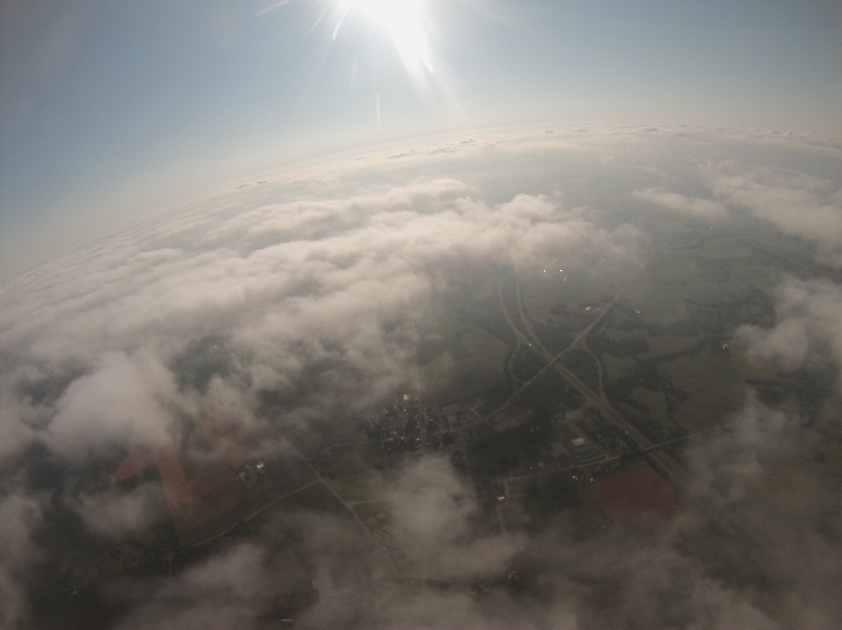
Why do we care?
It’s the best way to see what’s actually going on in the atmosphere

Slide 19
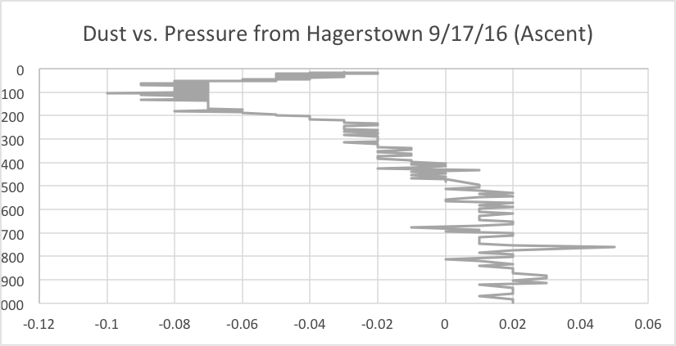
Dust
Dust Density vs. Pressure from NS58 - The results aren’t what’s expected.
Measurement of dust in the air - Notice the unusual increase at the end?
Satellites can tell us if there’s dust in the column of air, but not where that dust is coming from

Slide 20
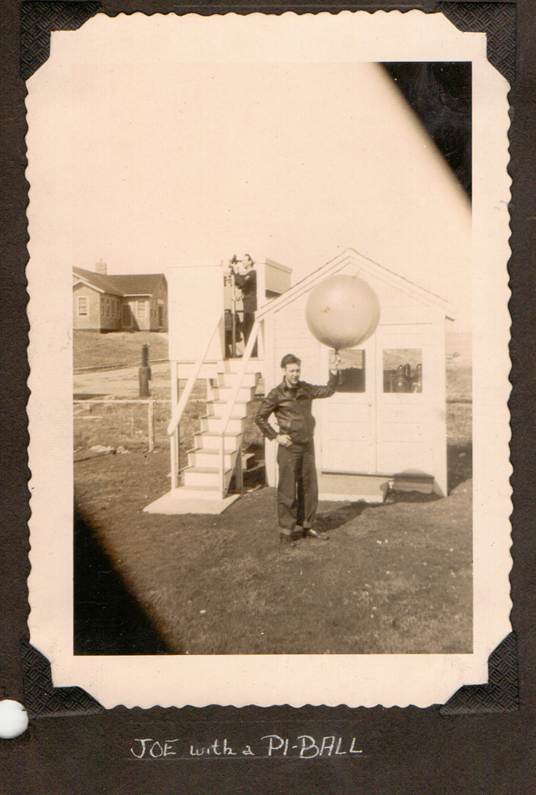
The History of HAB (High Altitude Ballooning)
Before satellites, high altitude ballooning was the only way to get weather data
Joe Boyle, my Grandfather, getting ready to launch a weather balloon

Slide 21
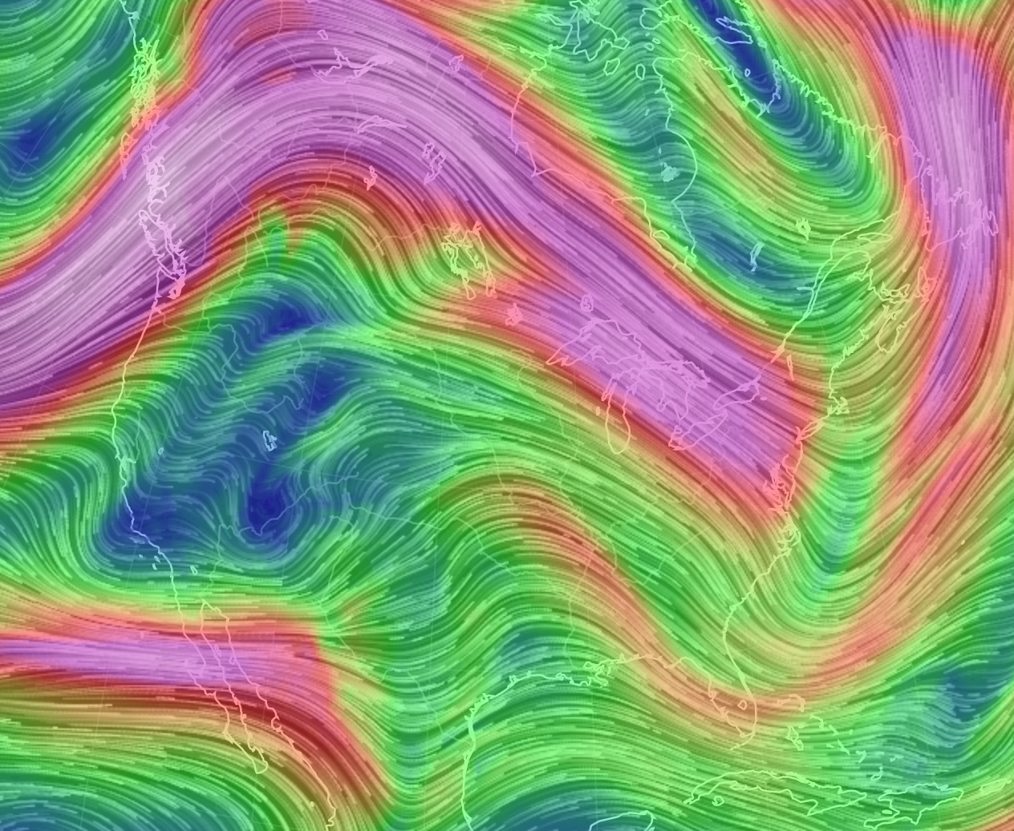
Fancy satellite images are great but...
These awesome images can only show us a snapshot of what’s going on
They predict information using math and physics
250mb winds (or the Jet Stream in pink), courtesy of earth.nullschool.net

Slide 22
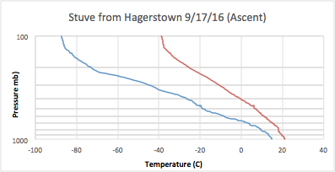
With a weather balloon, you’re flying through the air, actively measuring what’s happening

Slide 23
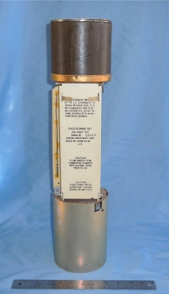
What are they telling us?
Temperature
Pressure
Relative Humidity
Wind Speed
Direction
- NOAA launches hundreds of these every day!
1960’s Style Radiosonde

Slide 24
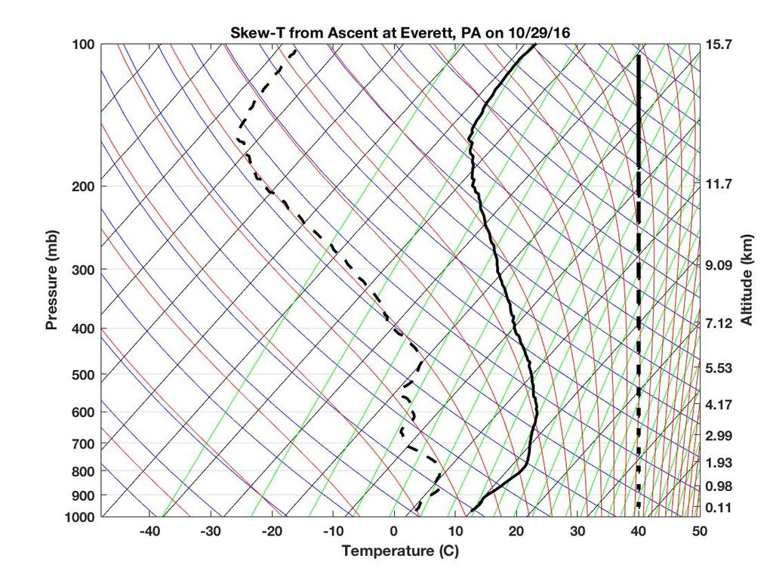
All the data helps us accurately predict the weather
This is a Skew-T diagram
Meteorologists use these to help tell when it might rain, snow, or even where the clouds are.

Slide 25
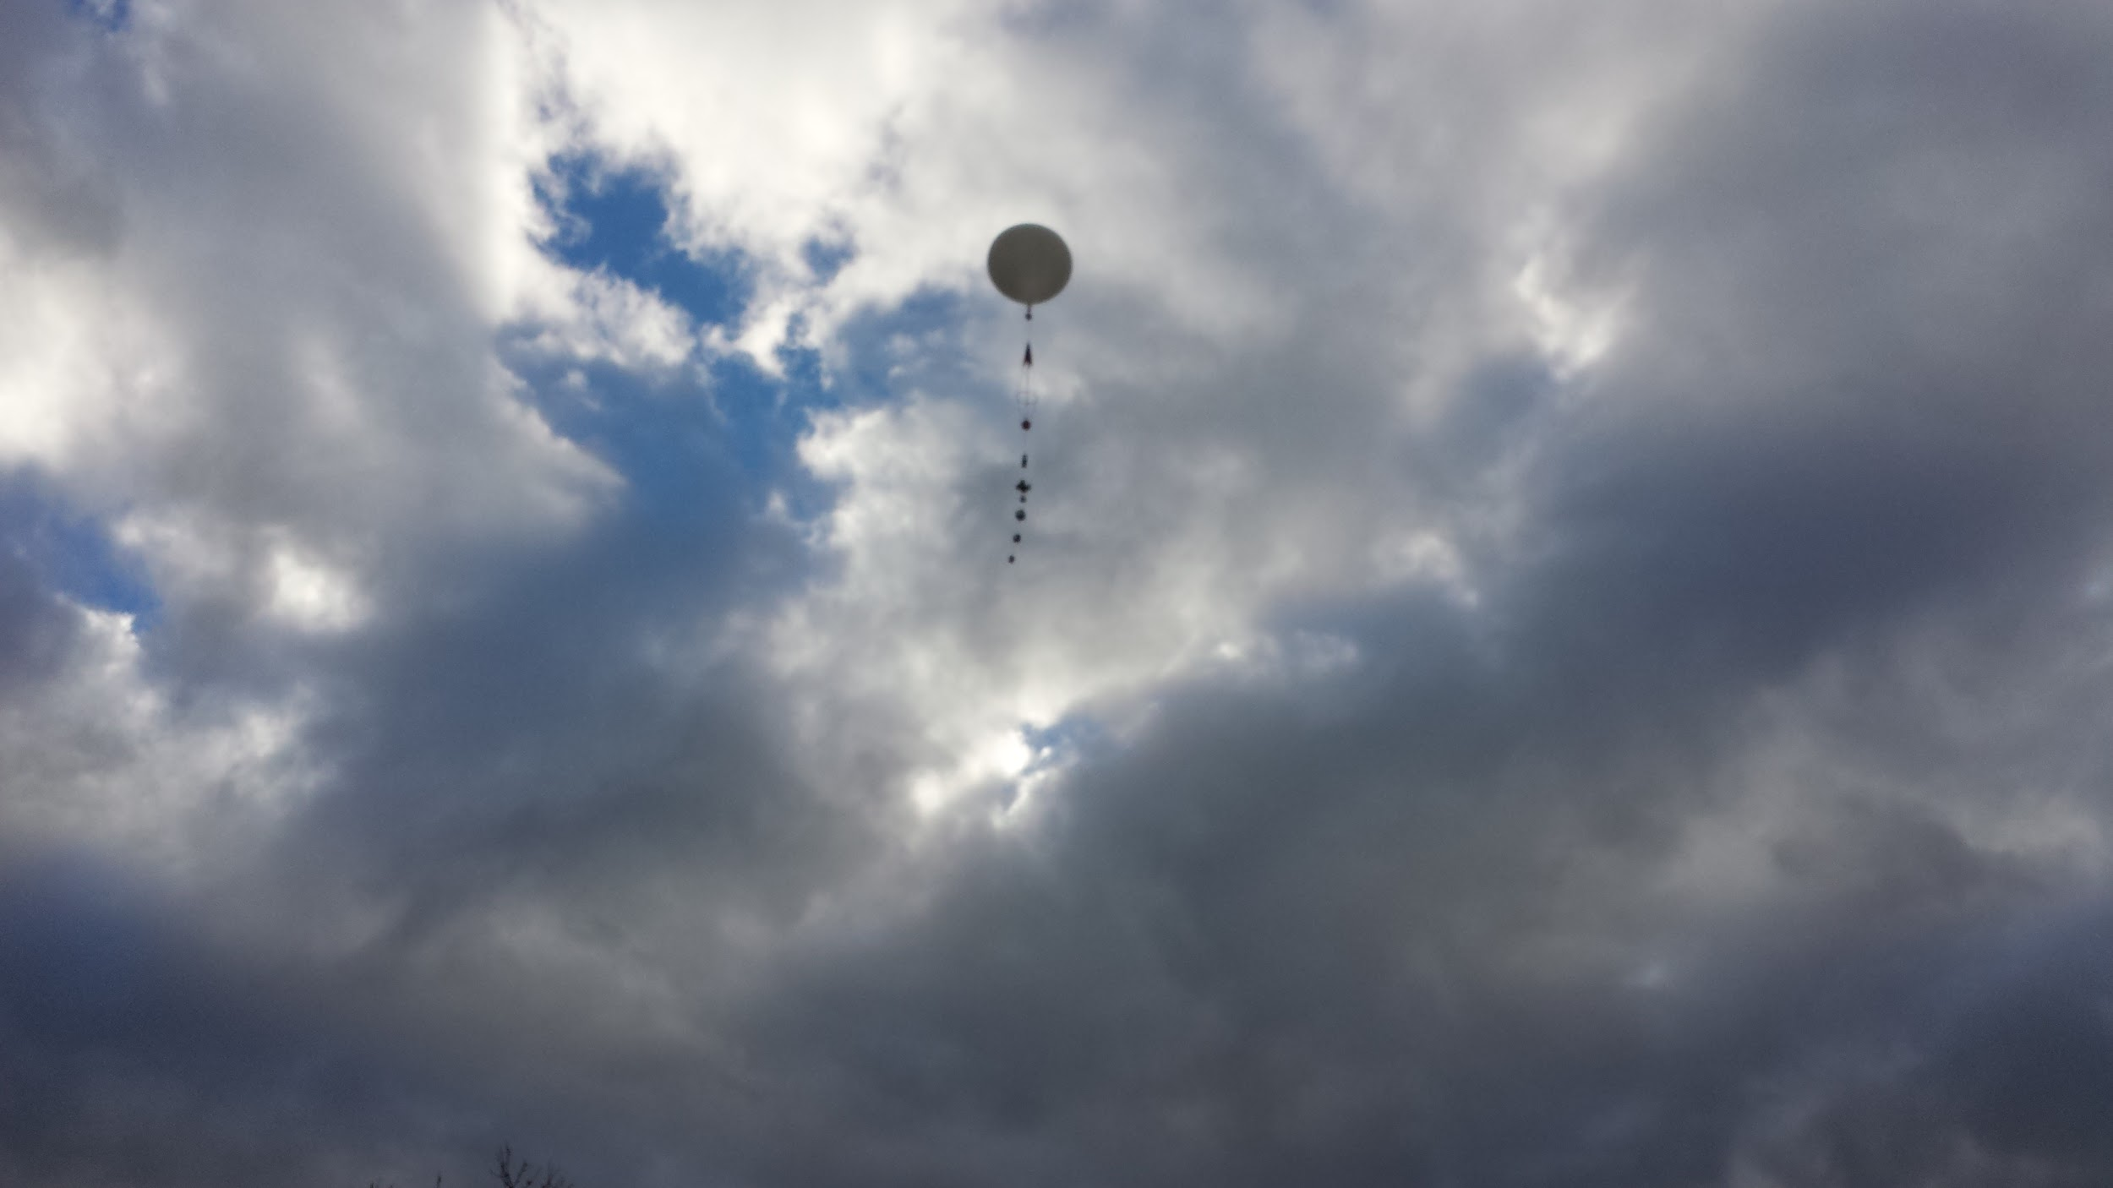
All of this information matters

Slide 26
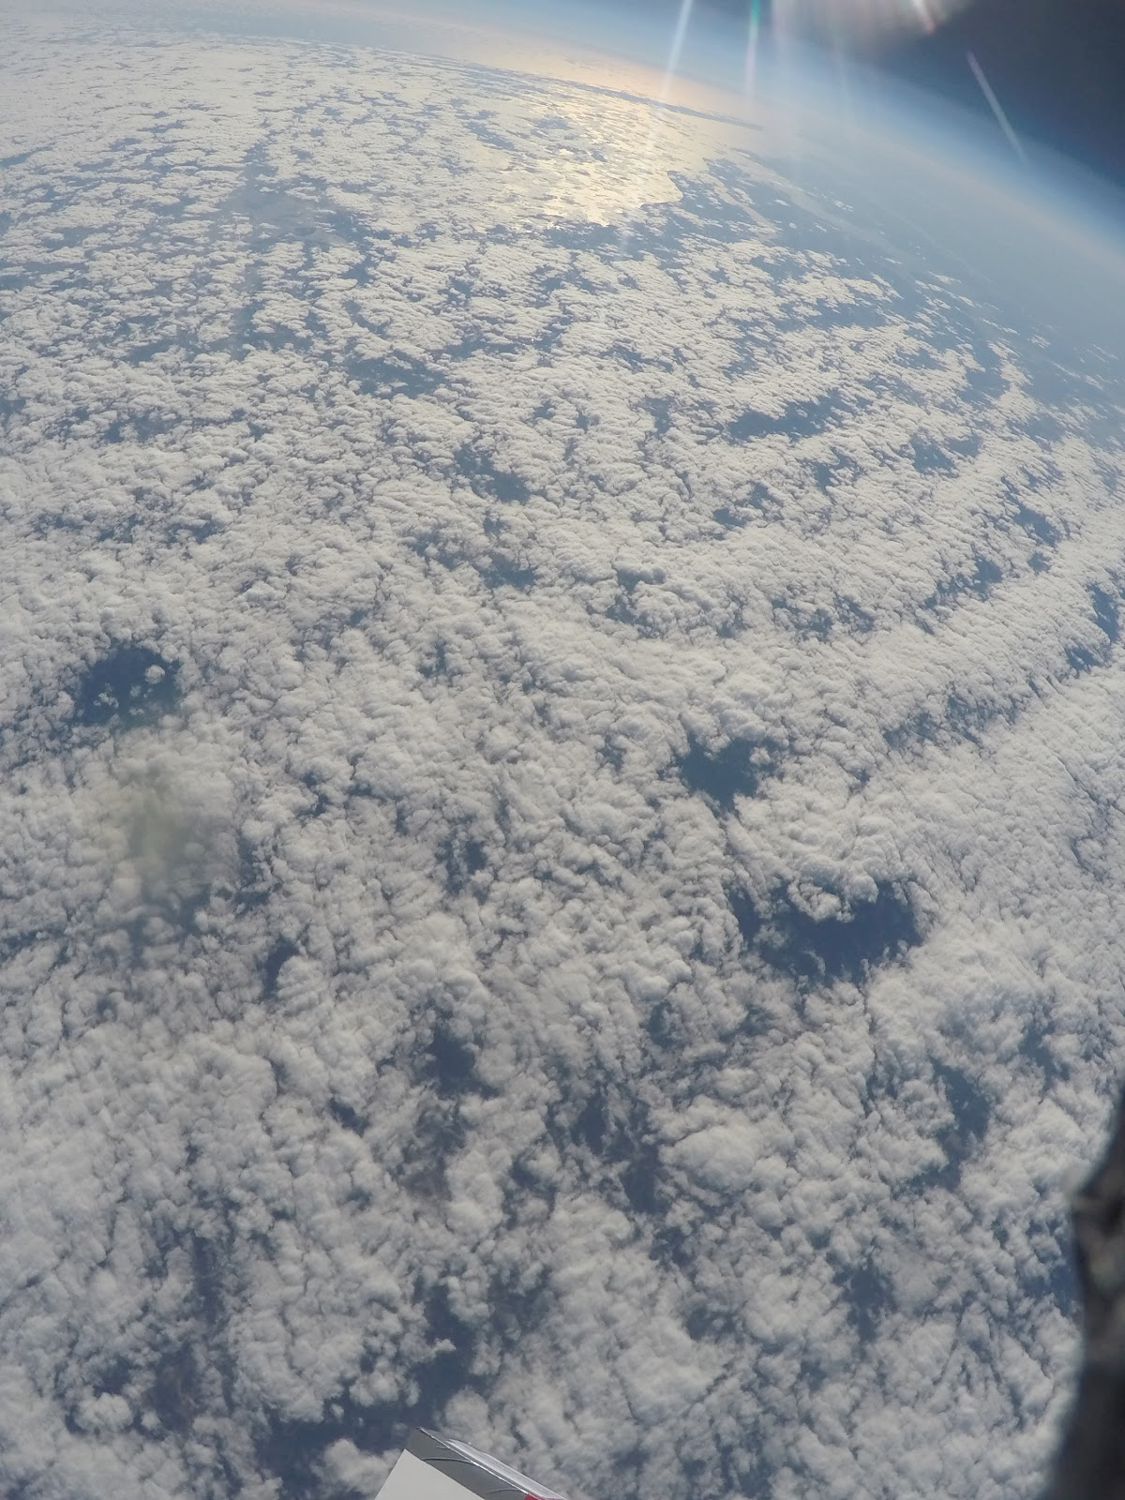
Clouds
During the day, they can help keep temperatures down (cooler)
At night, they can help keep the temperatures up (keep us warmer)

Slide 27
Or they can tell us if rain is coming
When red and blue are lines relatively close to each other (moisture/temp), there’s a lot of moisture in the air

Slide 28
What Satellite Imagery Tells us
https://earth.nullschool.net/#2016/09/16/1500Z/wind/surface/level/overlay=total_precipitable_water/orthographic=-87.17,38.50,1513/loc=-78.680,39.274

Slide 29
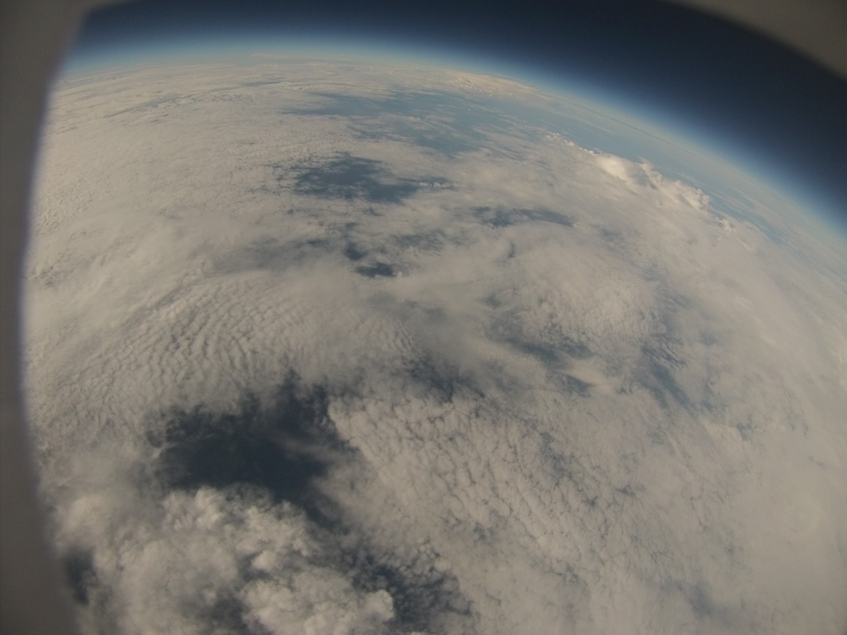
It’s just really fun!

Slide 30
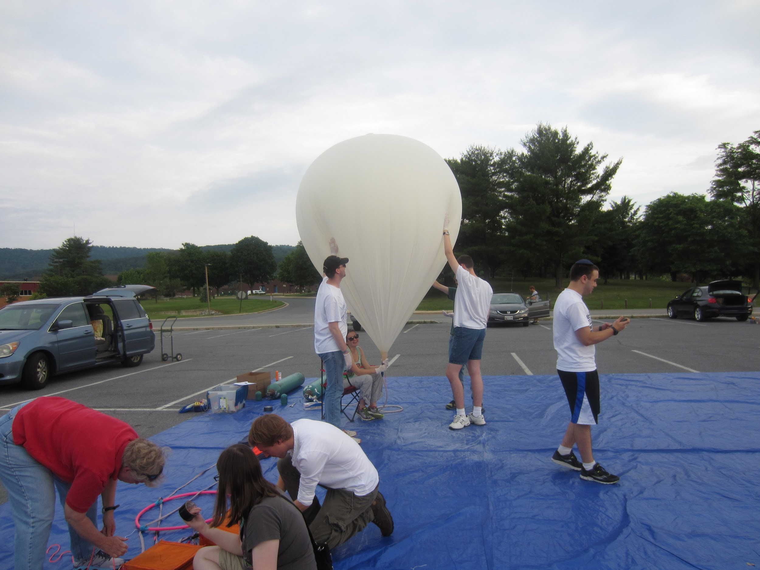
And everyone’s invited to our next launch!
When?
Saturday 11/12 or Sunday 11/13
Where?
Final decision made on Wednesday or Thursday based on weather and ground track
Be sure to preregister now to get the emails about next launches:
http://bit.ly/UMDHABlaunch
(everyone who preregisters WILL be emailed)
Filling the balloon for NS58

