Slide 1
STEM Workshop: Arduino
Lesson 4: Introduction to Arduino Programming
Brought to you by the University of Maryland Balloon Payload Program!

Slide 2
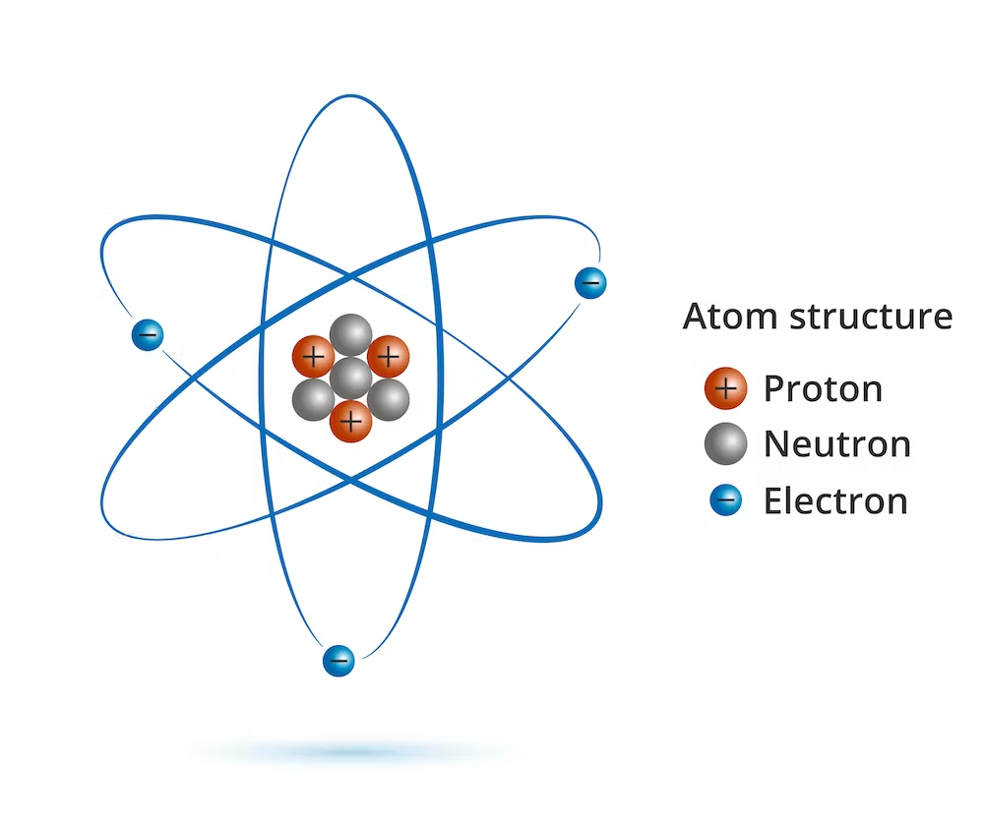
Electricity isn’t magic!
The universe is made of tiny particles called atoms
Atoms have even smaller, negatively charged particles flying around them, called electrons

Slide 3
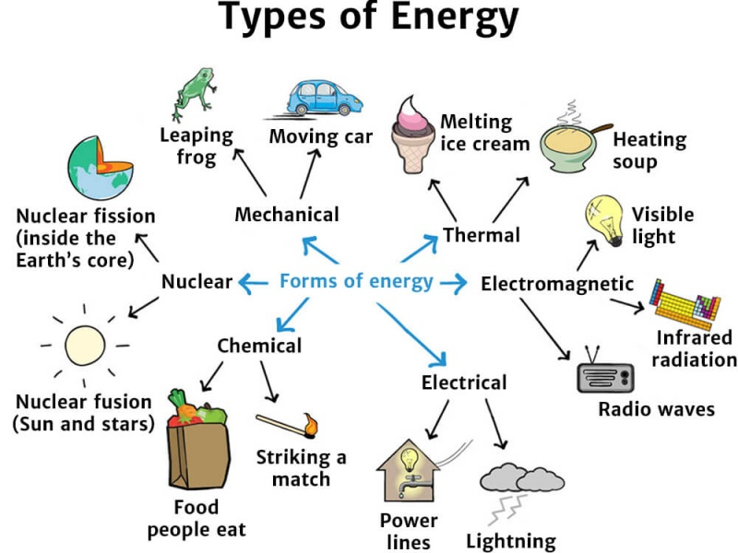
Electrons can do things for us

Slide 4
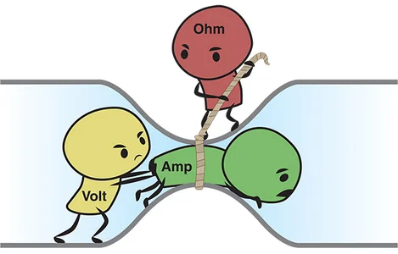
Can we describe electron behavior?
Voltage - the amount of force electrons are being pushed with
Current - the amount of energy going through the circuit
Resistance - how hard it is to push electricity along

Slide 5
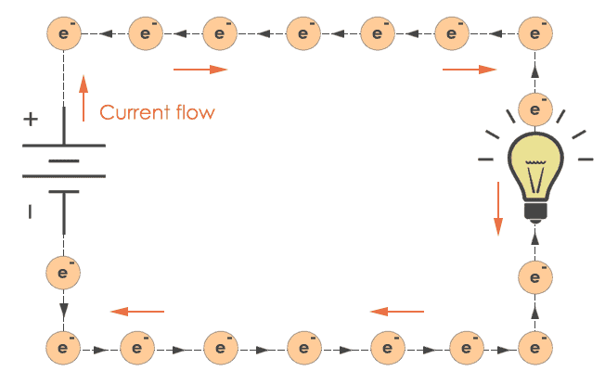
How do electrons work in circuits?

Slide 6

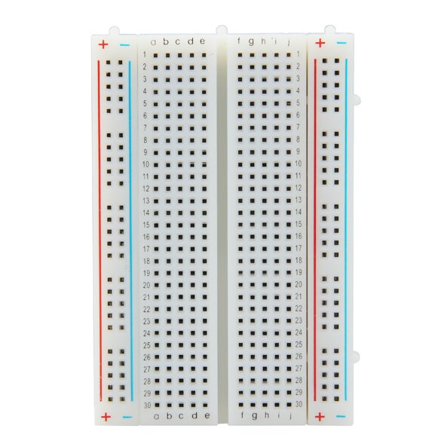
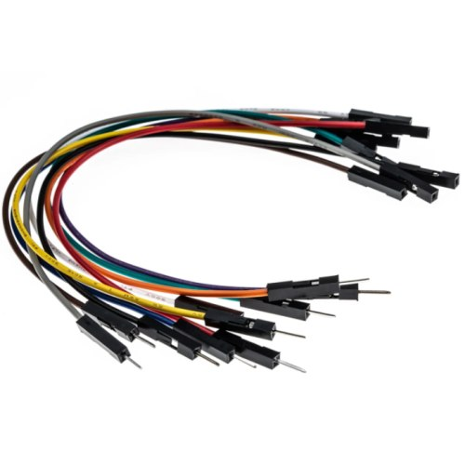
How to make circuits
Power Supply
Breadboard
Connections
And any other components you would like to add!

Slide 7
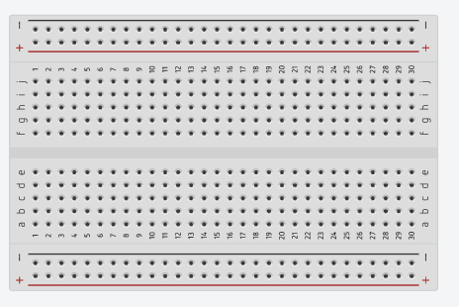
How to use a breadboard
Split in two halves (no electrical connection across the two halves)
Numbered Rows- electrical connection across each row
+/- Columns- used for power supply
= plus side of battery
= minus side of battery (ground)

Slide 8
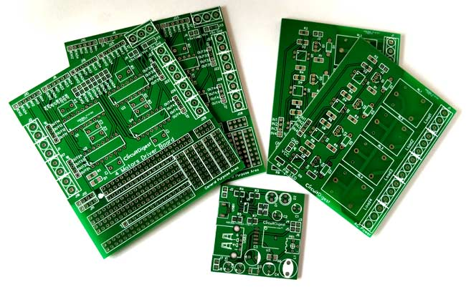
Why use a breadboard?
Breadboard
Used to prototype (“rough draft”) circuits
Easy to unplug and plug things in (instead of soldering)
Cheaper and easier than making a printed circuit board (PCB)
PCB

Slide 9
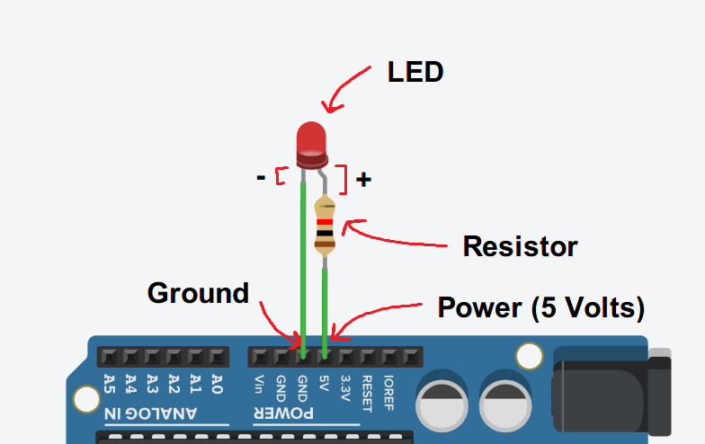
Simple LED circuit explained
Cathode (shorter)
Anode (longer)

Slide 10
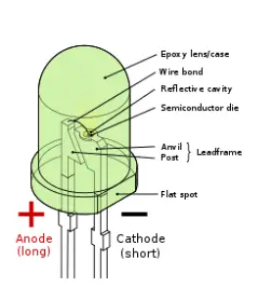
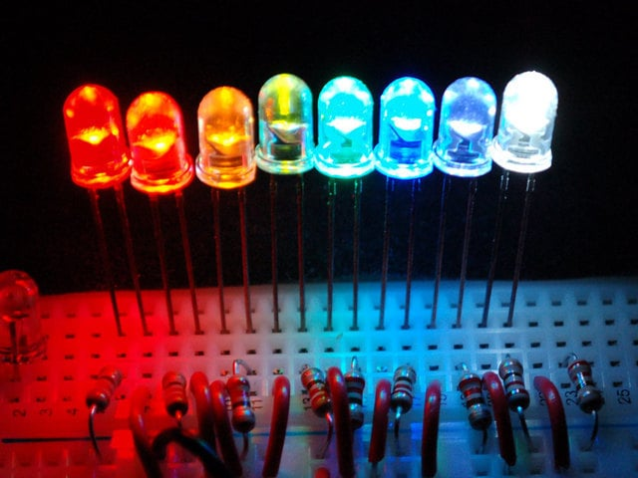
What is an LED?
LED stands for Light-Emitting Diode
A diodes can only let current through one way, which is why an LED has a side that must be connected to + (long) or - (short)
SAFETY: Should be connected to a 220 Ohm resistor or it will get really hot, burn out, and stop working :(

Slide 11

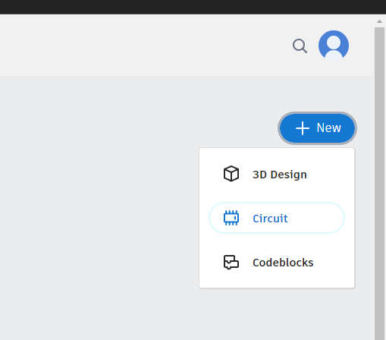
Coding and designing circuits
Tinkercad.com
Username:
umdstemworkshop@gmail.com
Password:
Spring2023

Slide 12
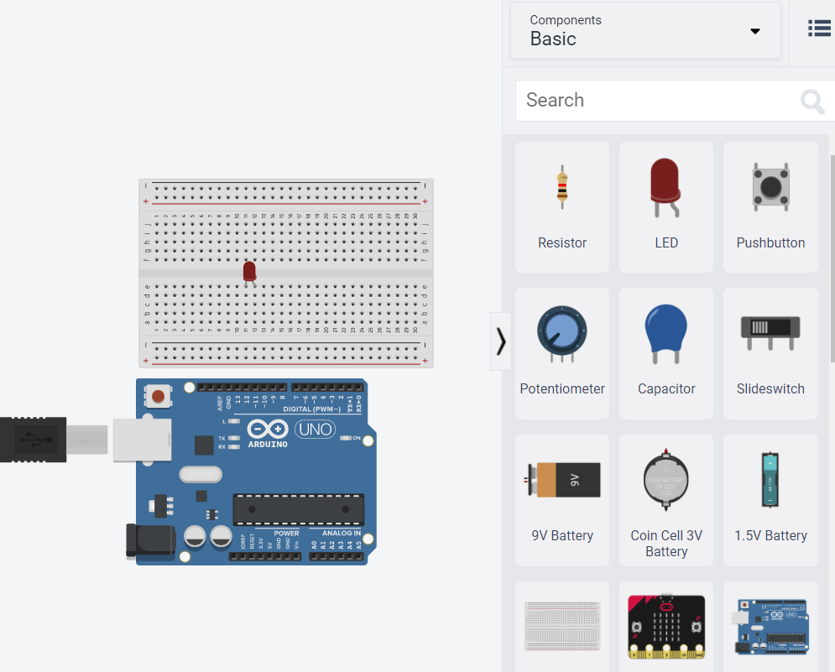
Drag a LED to the breadboard
Make sure that the LED connectors are in different rows

Slide 13
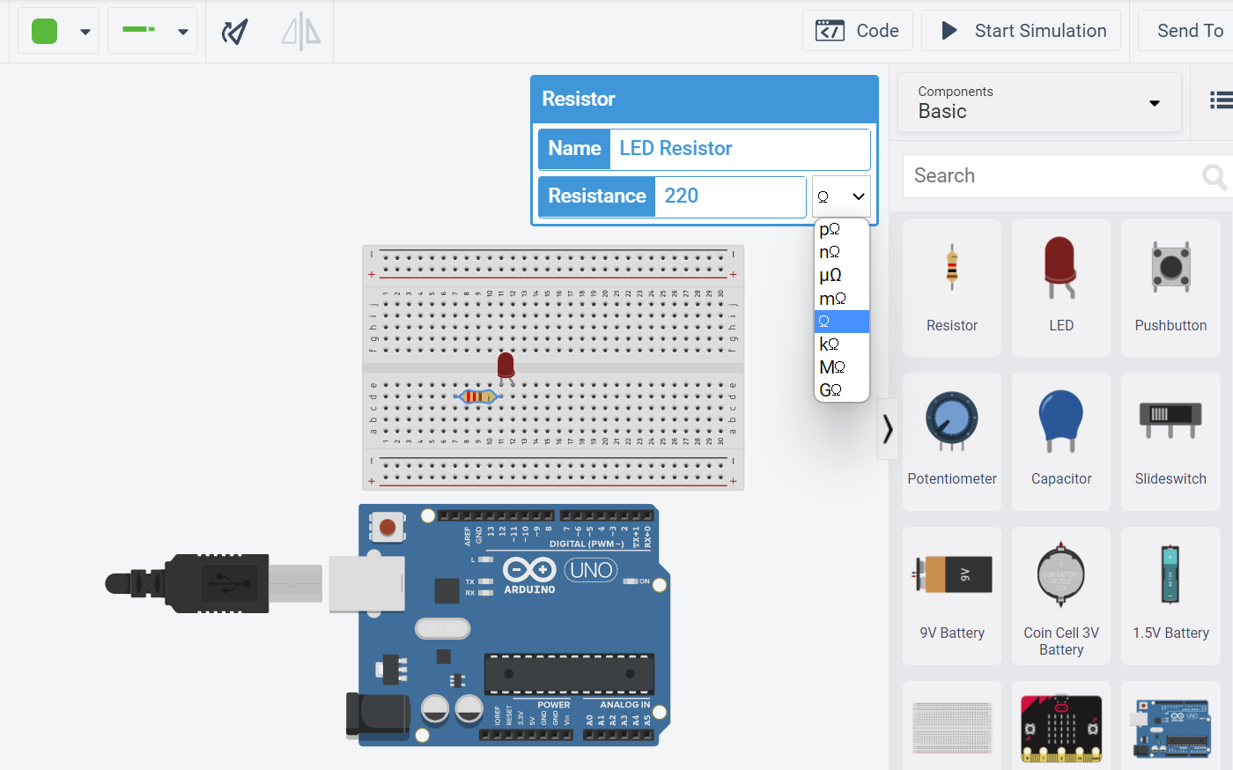
Rotation Button
Change the resistor to 220 Ω (NOT kΩ)
Rotation: use the rotation button or select the component and press the R key
Notice how the resistor also connects to a column other than where the LED is

Slide 14
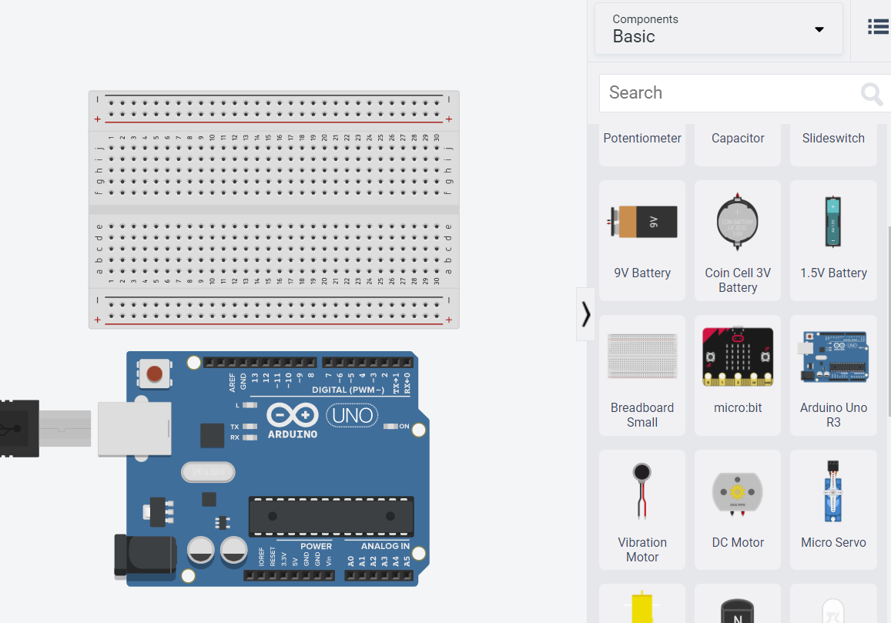
Let’s get started! (Blinking LED)
Drag out an Arduino Uno and a breadboard to your workspace

Slide 15
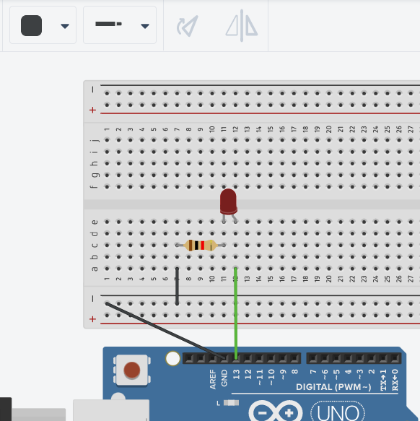
Click the hole to make a wire
Connect:
Curved LED connector to PIN 13 on the Arduino
Left end of the resistor to the ground (-) column
Ground column to GND on the Arduino
To change the color click the change color button
You can change colors

Slide 16
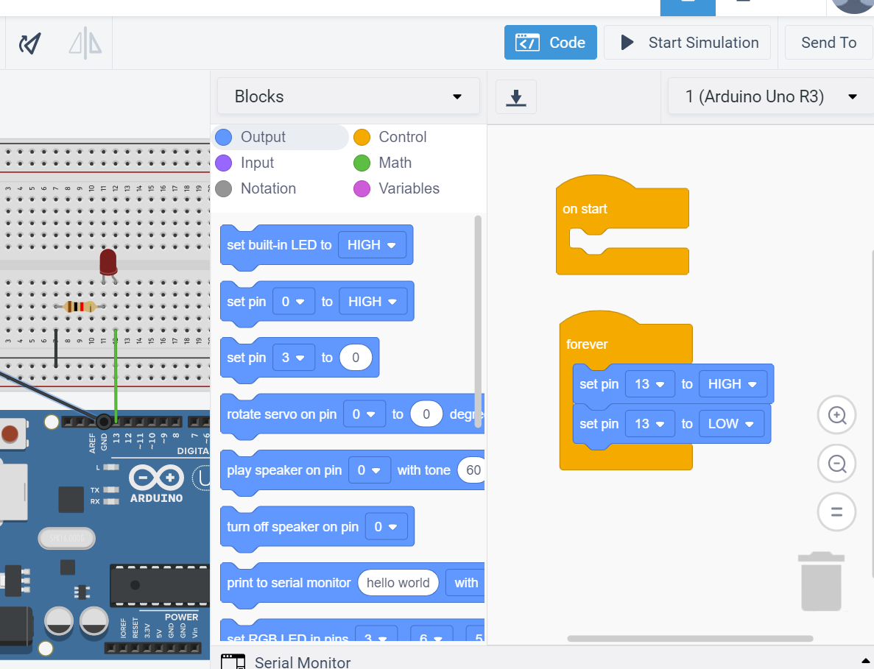
Click the code button
We want the LED to turn on and off so drag the second block and change:
Pin from 0 to 13
First command block is set to HIGH (on)
Second command block to LOW (off)

Slide 17
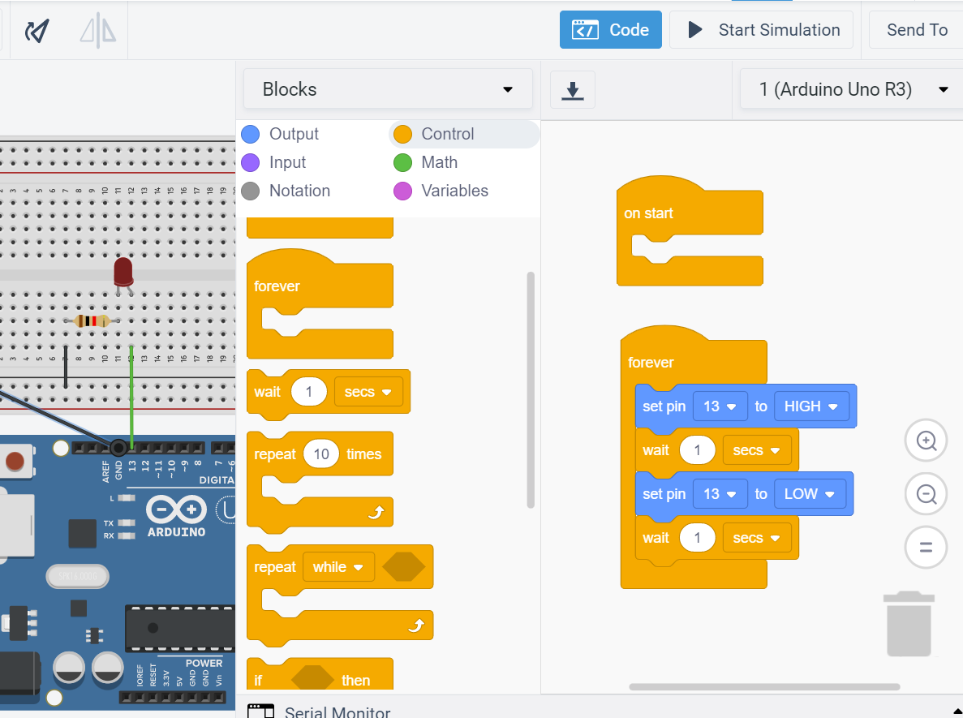
Click the control button
We need the led to wait a little before it turns on and off:
Drag the “Wait” command and put them after both of the on and off commands
Click start simulation and your LED should blink!

Slide 18
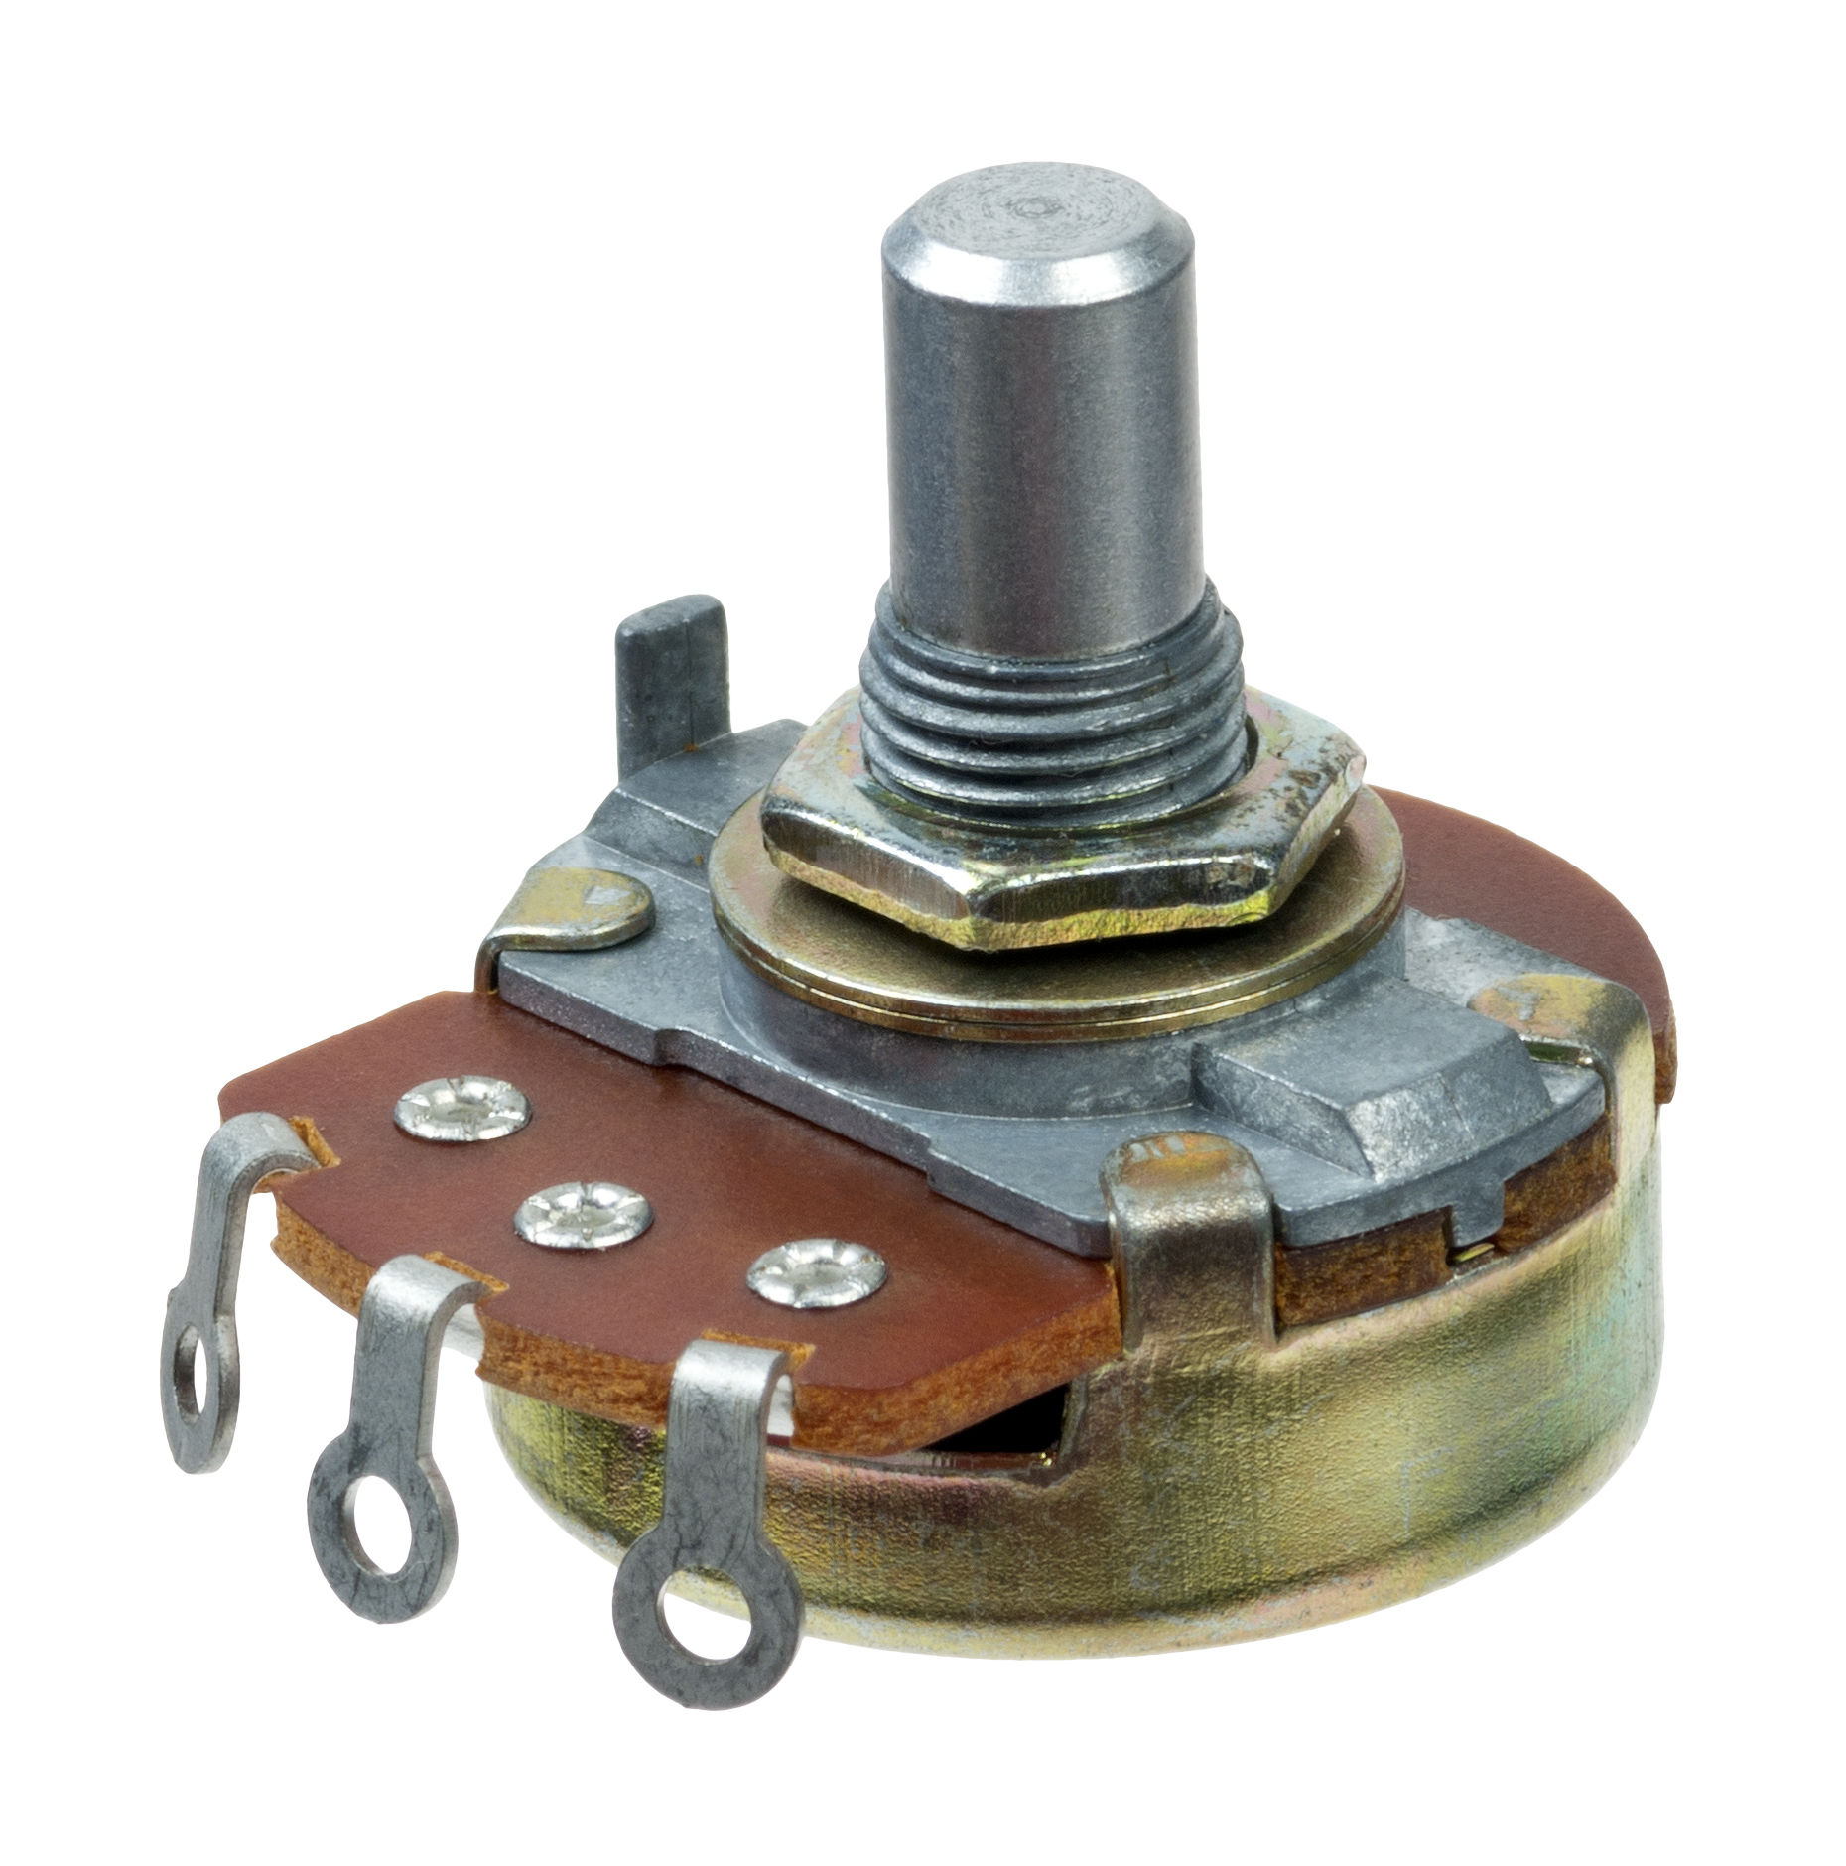

What is a potentiometer?
A potentiometer is a variable resistor (a resistor that changes values) based on how much it is twisted
Think of a volume dial or an adjustable light!

Slide 19
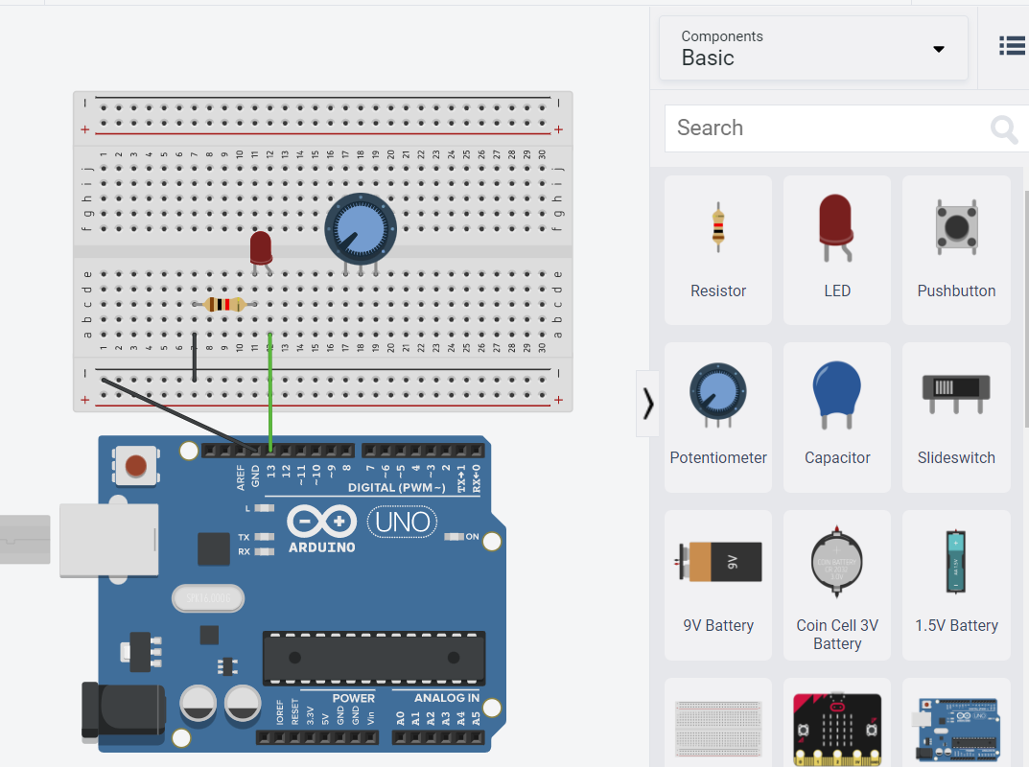
Drag out a potentiometer and put it on your breadboard

Slide 20
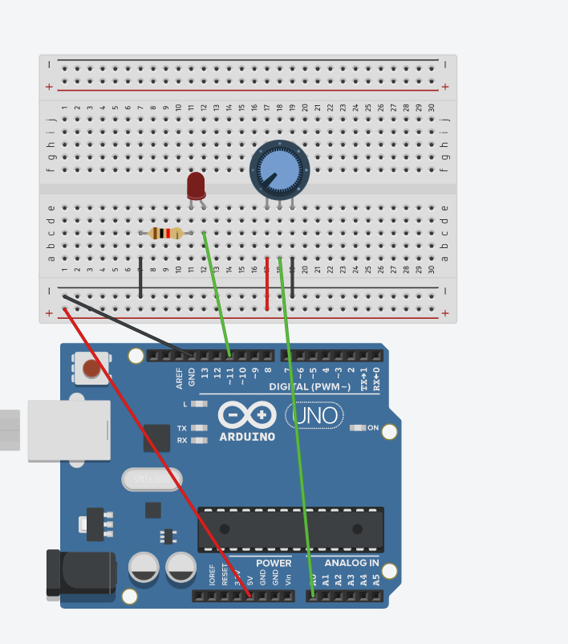
Connect the potentiometer
Left pin to the power column
Power column to 5V on Arduino
Middle pin to A0 on arduino
Right pin to ground column on Arduino
Change the LED pin to 11

Slide 21
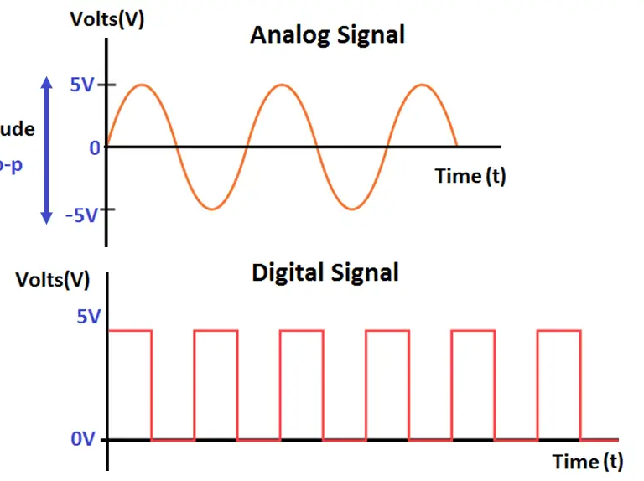
Two kinds of signals: digital and analog
Analog: can give many different values
Think of decimals or fractions between 1 and 0
Digital: Only two values (HIGH = on LOW = off)
Think of only 1 and 0

Slide 22
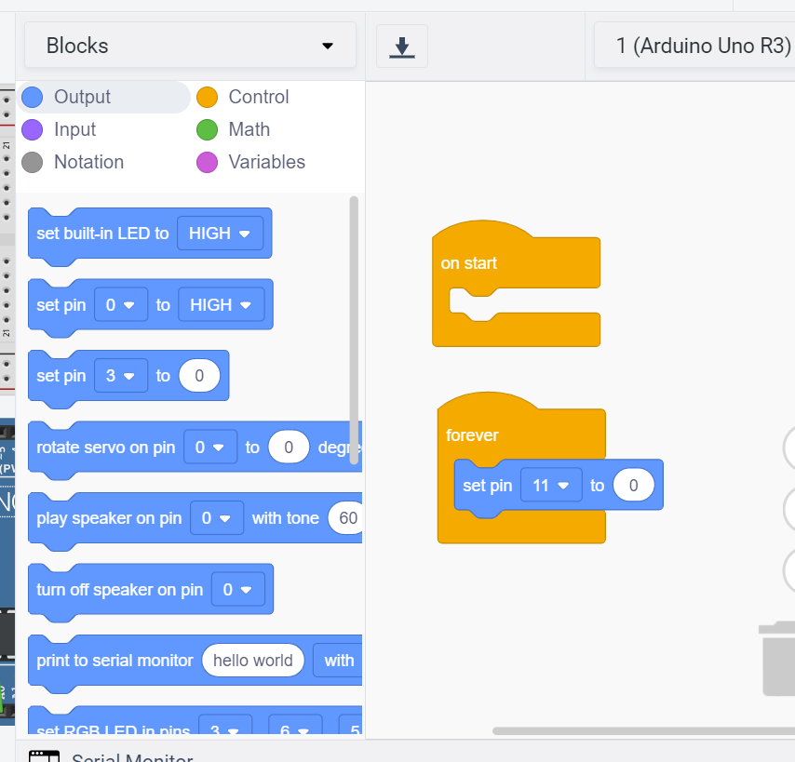
We want the potentiometer to control the LED so open up the code:
Delete everything
Set pin command (3rd one on the list) and change it to pin 11

Slide 23
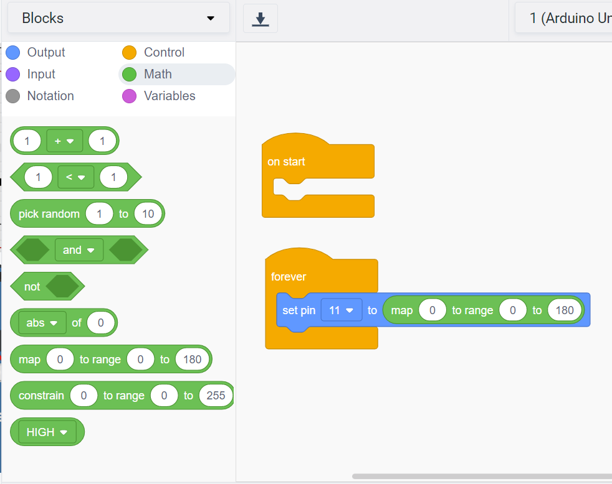
Go to math
Drag the map command inside the set pin command

Slide 24
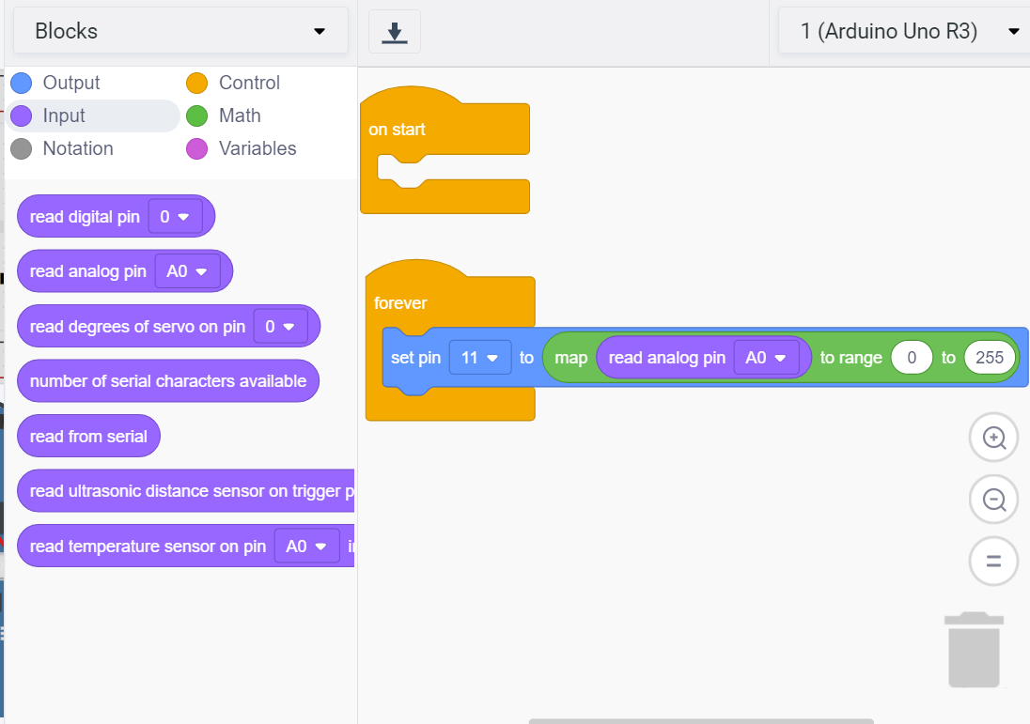
Go to input and drag the read analog pin command inside the map command
Change the value of the range to “0 to 255”
Run the simulation and twist the potentiometer around and see what happens!

Slide 25
Raise your hand once you’ve finished! We’ll come around and upload your code

